Slide 1
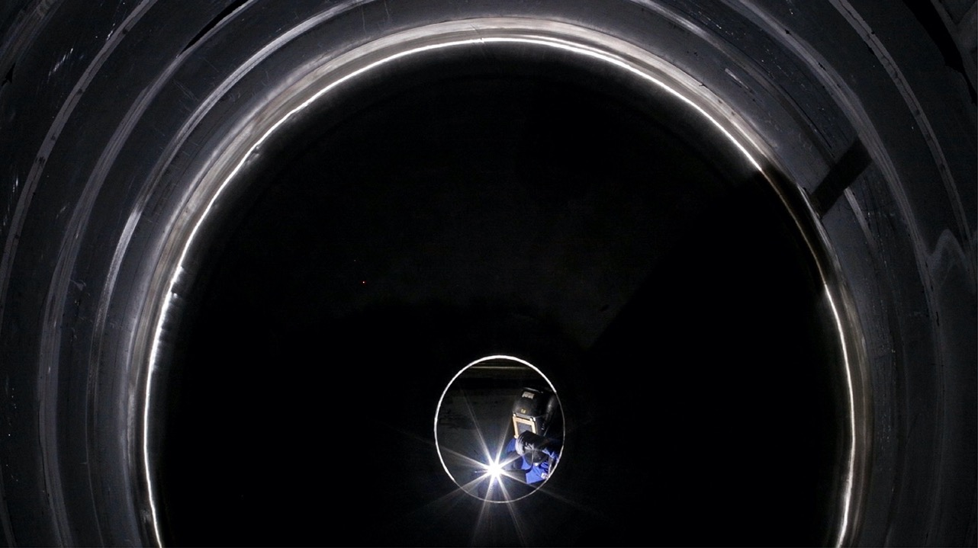
AIM Engineers India Pvt Ltd
Home
About Us
Facility
Portfolio
Clientele
AIM
E N G I N E E R S
I N D I A P R I V A T E L I M I T E D
HEAD OFFICE:
Plot No. PAP K 80 Phase II MIDC ,
Opp. Schindler Company, Chakan Pune, India- 410501
Website: www.aimengipl.com
Email: sales@aimengipl.com

Slide 2
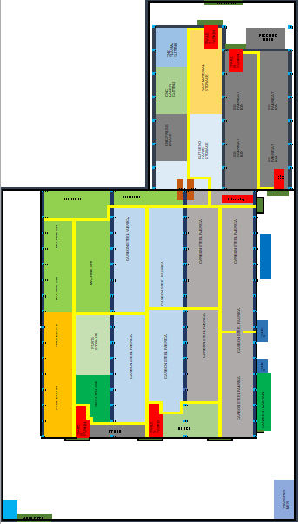
Emergency Evacuation Plan
Exit Gate
Assembly Point
We are here

Slide 3
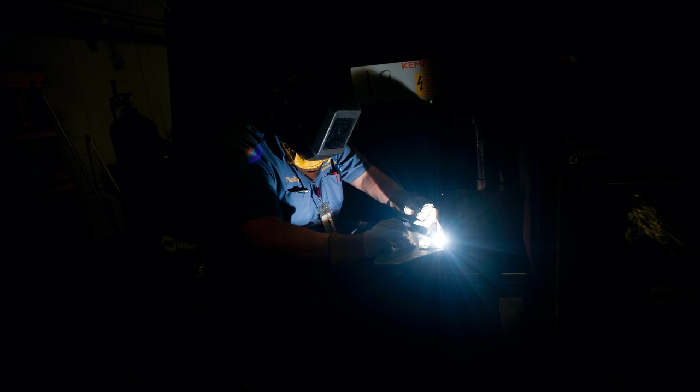
AIM Engineers India Pvt Ltd
Exit
Home
About Us
Facility
Portfolio
Clientele
MISION:
IMPROVING LIFE OF EVERYONE AROUND US By adopting the world class work ethics, by raising the standards & improving the culture of Indian industries to the level of developed countries, so India can Get Ahead and Stay Ahead.
VISION 2030:
AEIPL is now a HAPPY FAMILY of 1000 PRODUCTIVE, COMMITTED & ROLE MODEL Team Members, and is the benchmark for the whole engineering industry in India.
Core Values:
CONTINUOUS LEARNING
CUSTOMER FOCUS
CHALLENGING THE STATUS QUO
THINKING BIG

Slide 4
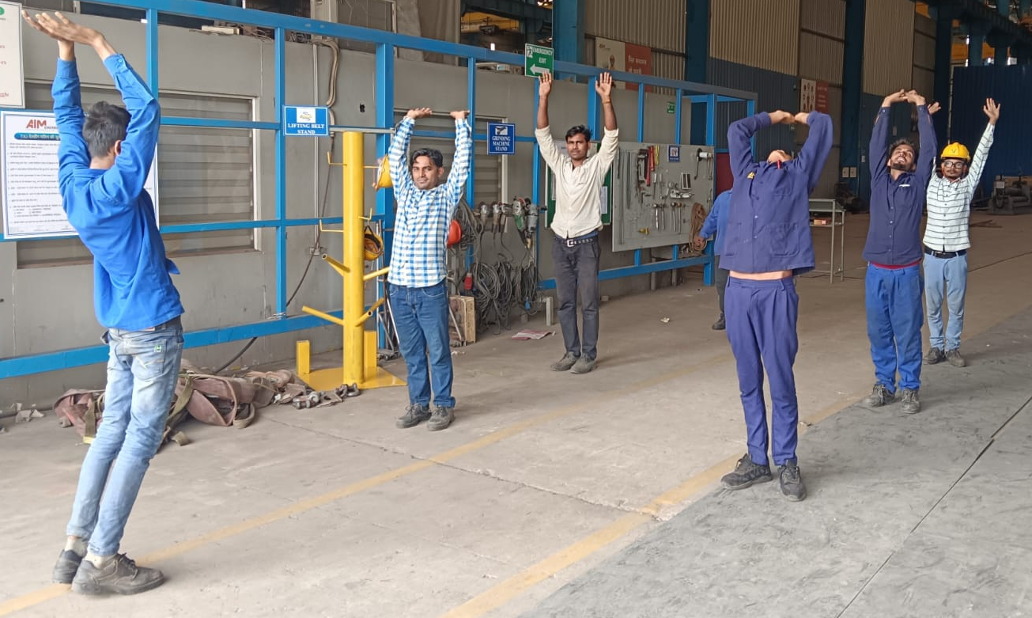
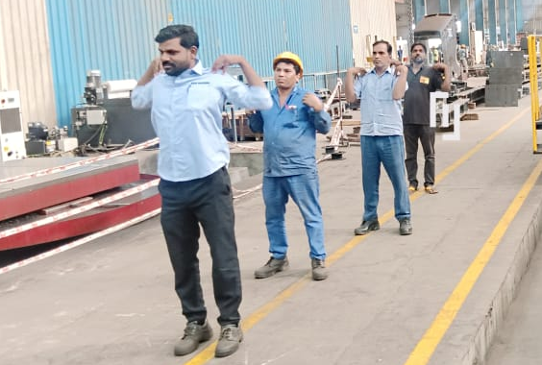
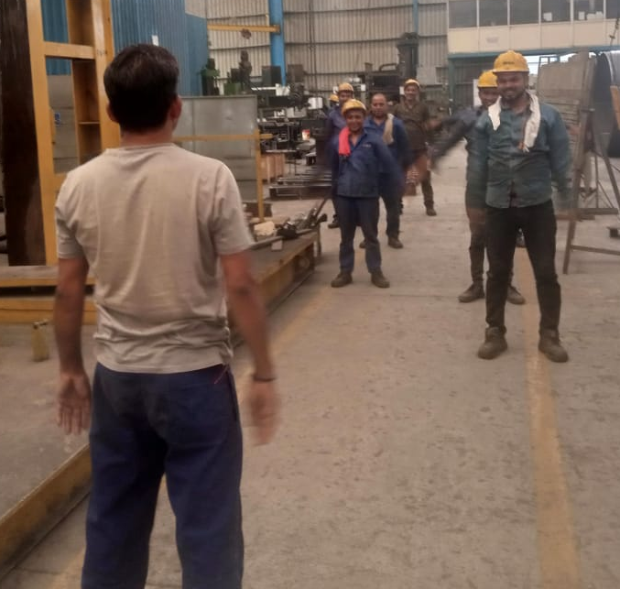
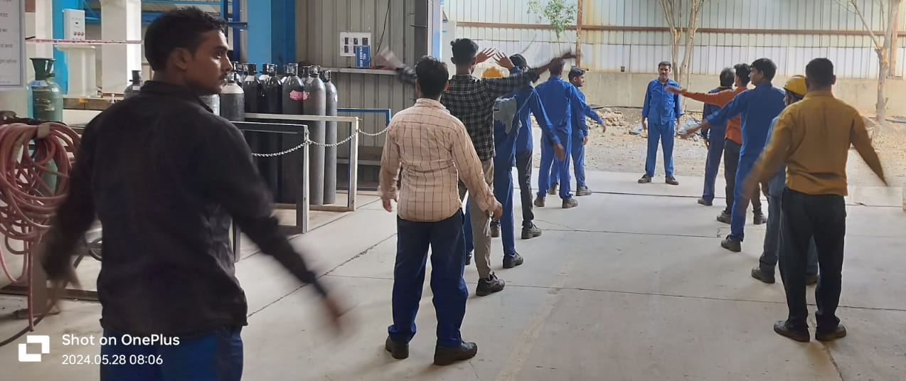
AIM Engineers India Pvt Ltd
Exit
Home
About Us
Facility
Portfolio
Clientele
Employee Engagement:
everyday a 10mins workout

Slide 5
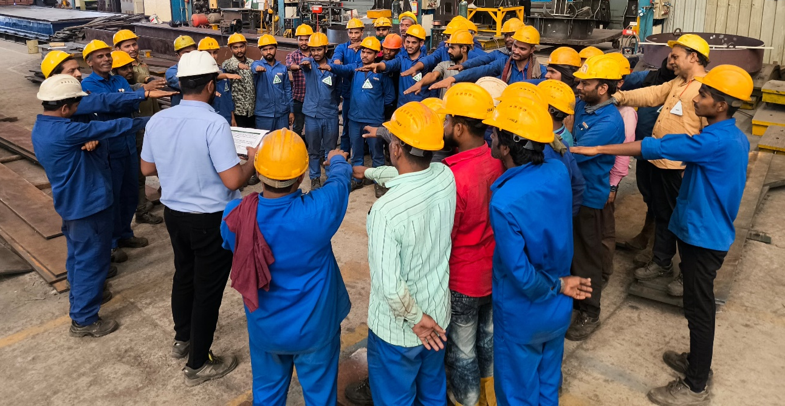
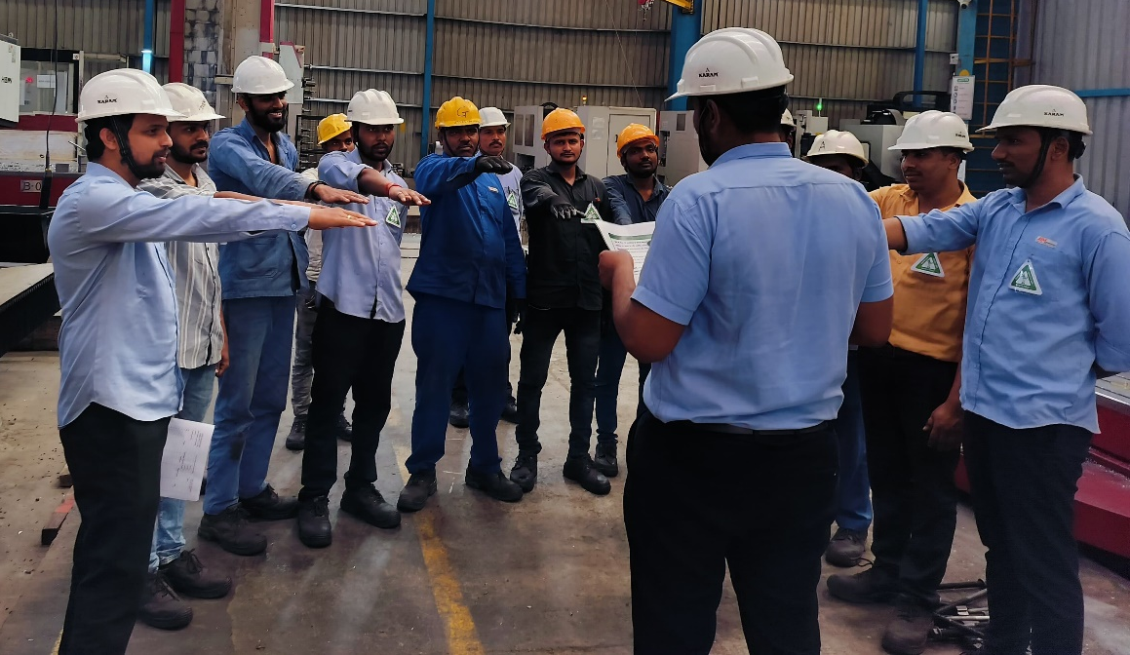
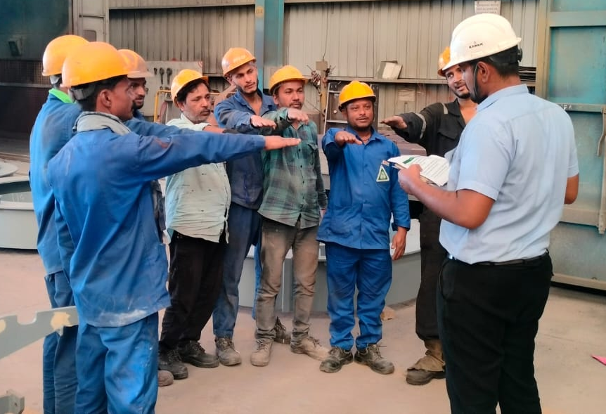
AIM Engineers India Pvt Ltd
Exit
Home
About Us
Facility
Portfolio
Clientele

Slide 6
AIM Engineers India Pvt Ltd
Exit
Home
About Us
Facility
Portfolio
Clientele
- Incorporated in 2017
- Expertise in manufacturing of Stainless Steel and Carbon Steel equipment's required for Chemical, Food, Mining and Construction industries
- We have very good experience in manufacturing of Stainless steel equipment's such as Heat Exchangers, Calendria, Reactors, Deodiser, Scrubber, Bleacher, Limpet and laser welded Jacketed vessels, Unitanks, BBT, Heater equipment's for edible oils, etc.
- We have also gained Specialty in Mining and construction equipment's such as Hoppers, Conveyer, Stone crusher frames, VSI Crusher, HSI Crusher, Chutes, Rotors and Structures.
- Our Defence portfolio includes structures for Missile Launching System(MLS) for Airforce and Army, Pinaka MBRL.

Slide 7
AIM Engineers India Pvt Ltd
Exit
Home
About Us
Facility
Portfolio
Clientele
Capacity | 300 Tons/month
Project equipment Fabrication – pressure vessel, heat exchanger, column etc. | 75
Structural work & heavy equipment fabrication work for Mining And Construction Equipment Division. | 225
Cranes | 14 Nos
10 Tons | 11
5 Tons | 3
Total No of Employees | 170 Nos
Engineers | 26
Skilled Labour | 60
Semi Skilled Labour | 65
Operators | 19
Total Plant Area | 13800 SQM
Area Under Crane | 7961
Open Area | 5839
Plasma Cutting :
3m X 12.5m SS – 50mm Thk, CS – 250mm Thk
2) Paint Booth – 4m X 4M X 15M long
3) Shot Blasting Booth – 4m X 4M X 15M long

Slide 8
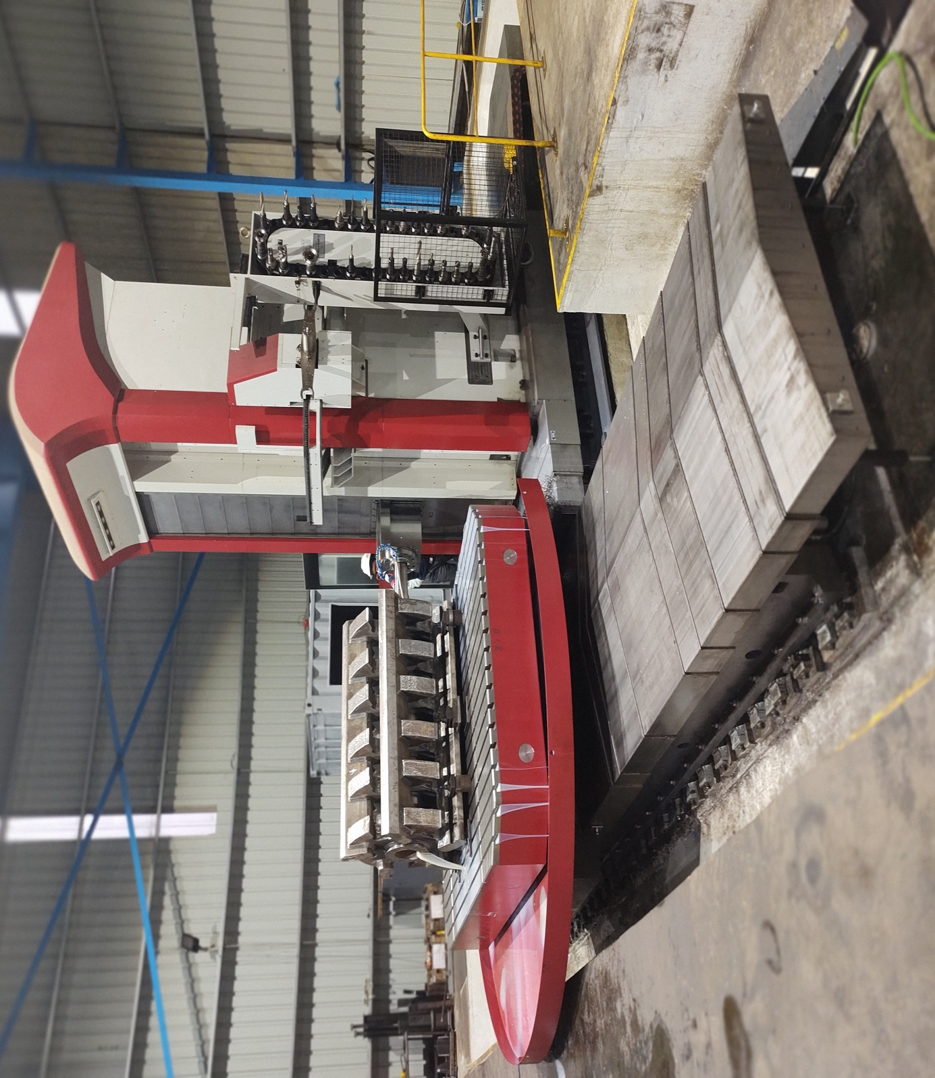
AIM Engineers India Pvt Ltd
Exit
Home
About Us
Facility
Portfolio
Clientele
FERMAT MAKE HMC 1
- SIZE
X-6100mm, Y-3000mm, Z- 2500mm,
- SPINDLE DIA- 150mm
- Ram(V Travel) - 700 mm
- SPINDLE STROKE(W travel) – 850mm,
- ROTARY TABLE SIZE 2500 X 3500mm
- LOADING CAP: 40 TON
- CNC Control – Heidenhain TNC 640
- Touch Probe – Heidenhain TS460

Slide 9
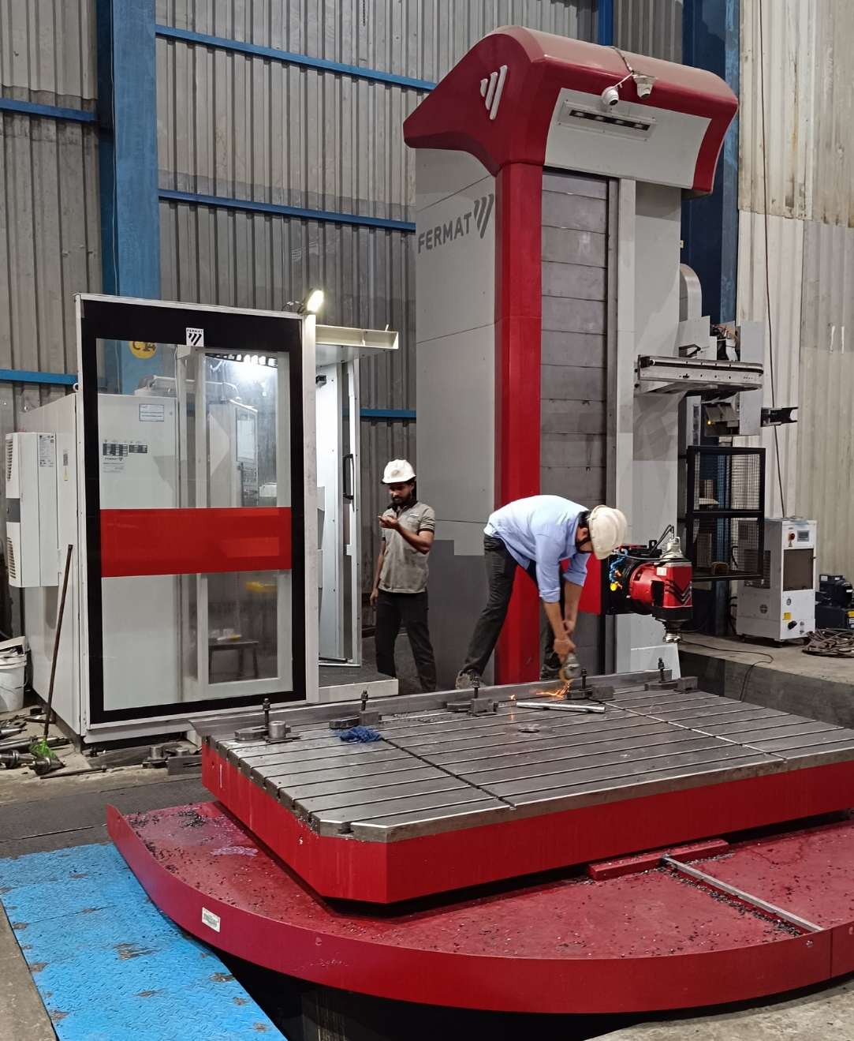
AIM Engineers India Pvt Ltd
Exit
Home
About Us
Facility
Portfolio
Clientele
FERMAT Make HMC 2
- SIZE
X-4000mm, Y-3000mm, Z- 1500mm,
- SPINDLE DIA- 130mm
- Ram(V Travel) - 700 mm
- SPINDLE STROKE(W travel) – 800mm,
- ROTARY TABLE SIZE 1800 X 2600mm
- LOADING CAP: 20 TON
- CNC Control – Fanuc

Slide 10
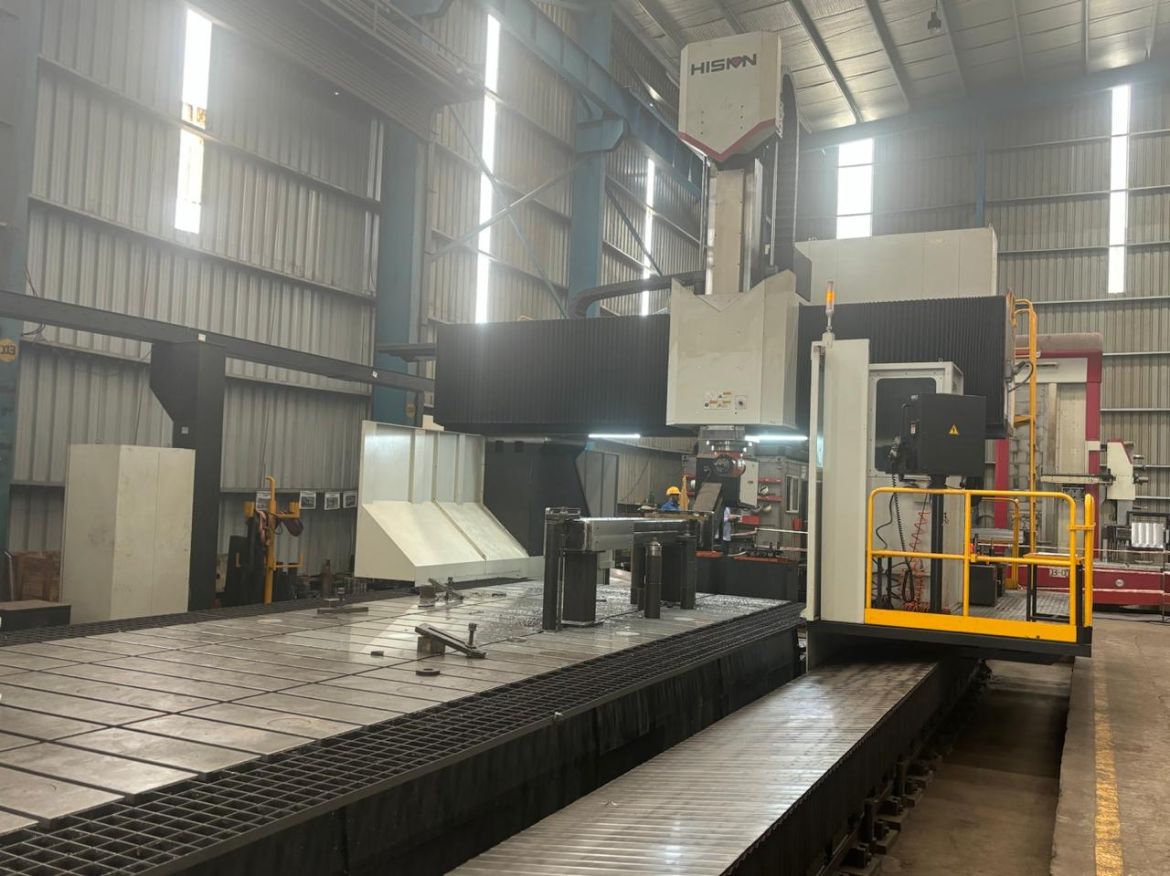
AIM Engineers India Pvt Ltd
Exit
Home
About Us
Facility
Portfolio
Clientele
HISION MAKE VMC
- SIZE
X-9000mm, Y-3600mm, Z- 1250mm,
- Spindle nose to table surface – 150mm to 1400mm
- CNC Control – Siemens 840Dsl
- Table Size – 2500mm x 8000mm

Slide 11

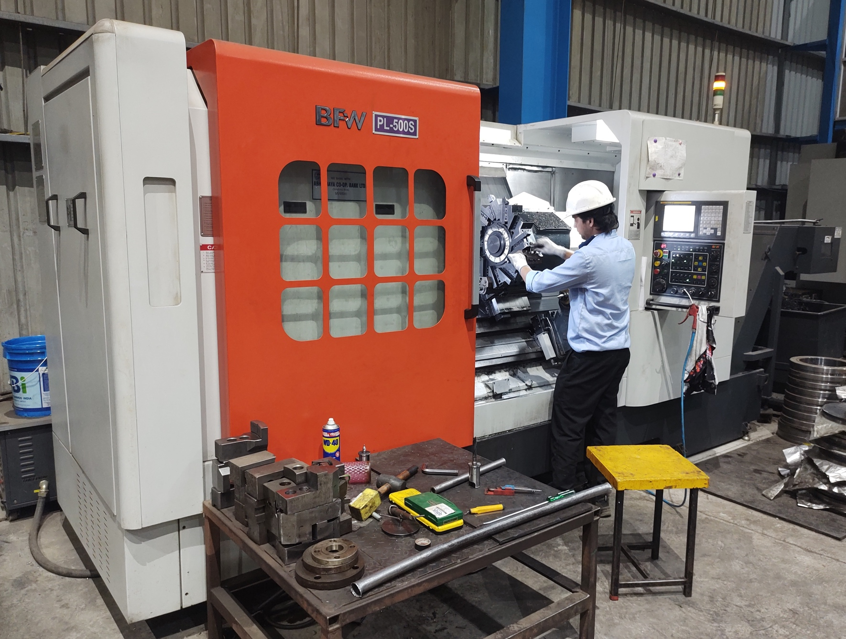
AIM Engineers India Pvt Ltd
Exit
Home
About Us
Facility
Portfolio
Clientele
BFW make CNC Lathe
Length Between Center 1000mm
Dia - 550mm
Chuck Dia - 400mm

Slide 12
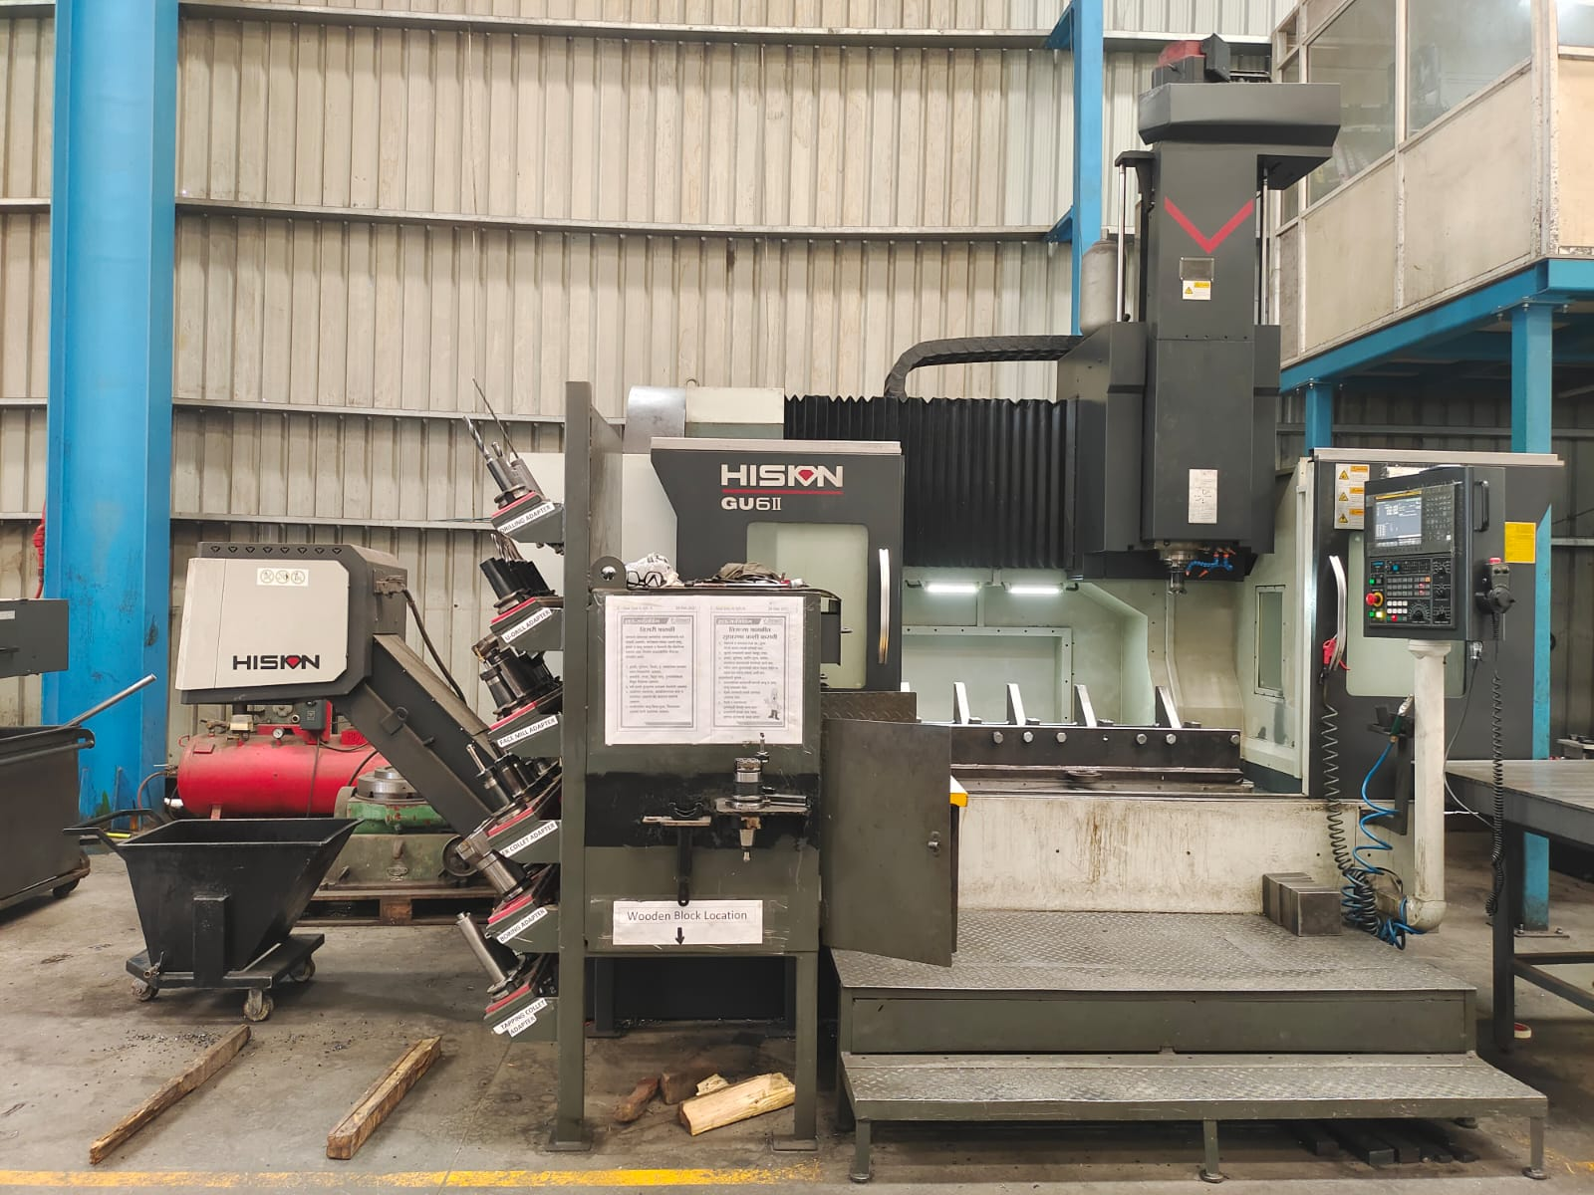
AIM Engineers India Pvt Ltd
Exit
Home
About Us
Facility
Portfolio
Clientele
HISION make VMC Model - GU6II
VMC 01
Size:
X-1500mm Y-850mm Z-700mm,
Table – 1500 mm X 850 mm With ATC and CTS

Slide 13
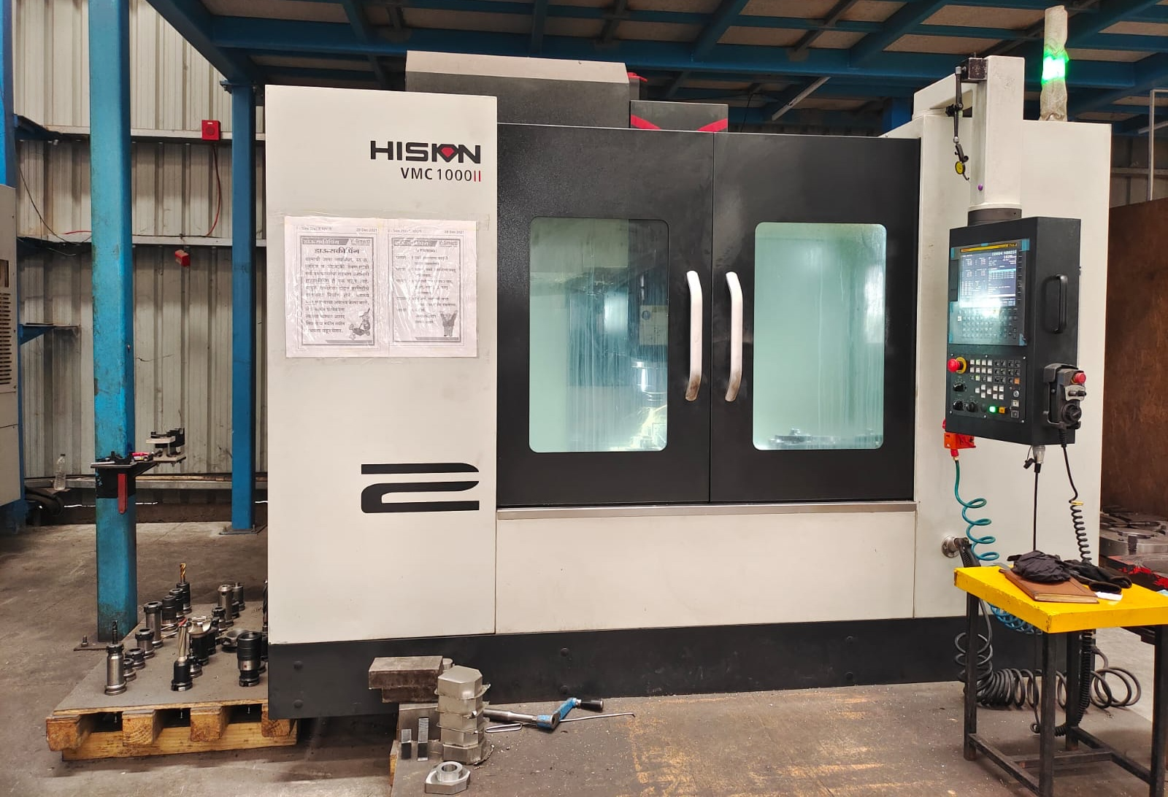
AIM Engineers India Pvt Ltd
Exit
Home
About Us
Facility
Portfolio
Clientele
HISION make VMC Model – 1000II
VMC 02
Size:
X-990mm Y-600mm Z-600mm,
Table – 1100 mm X 600 mm With ATC and CTS

Slide 14
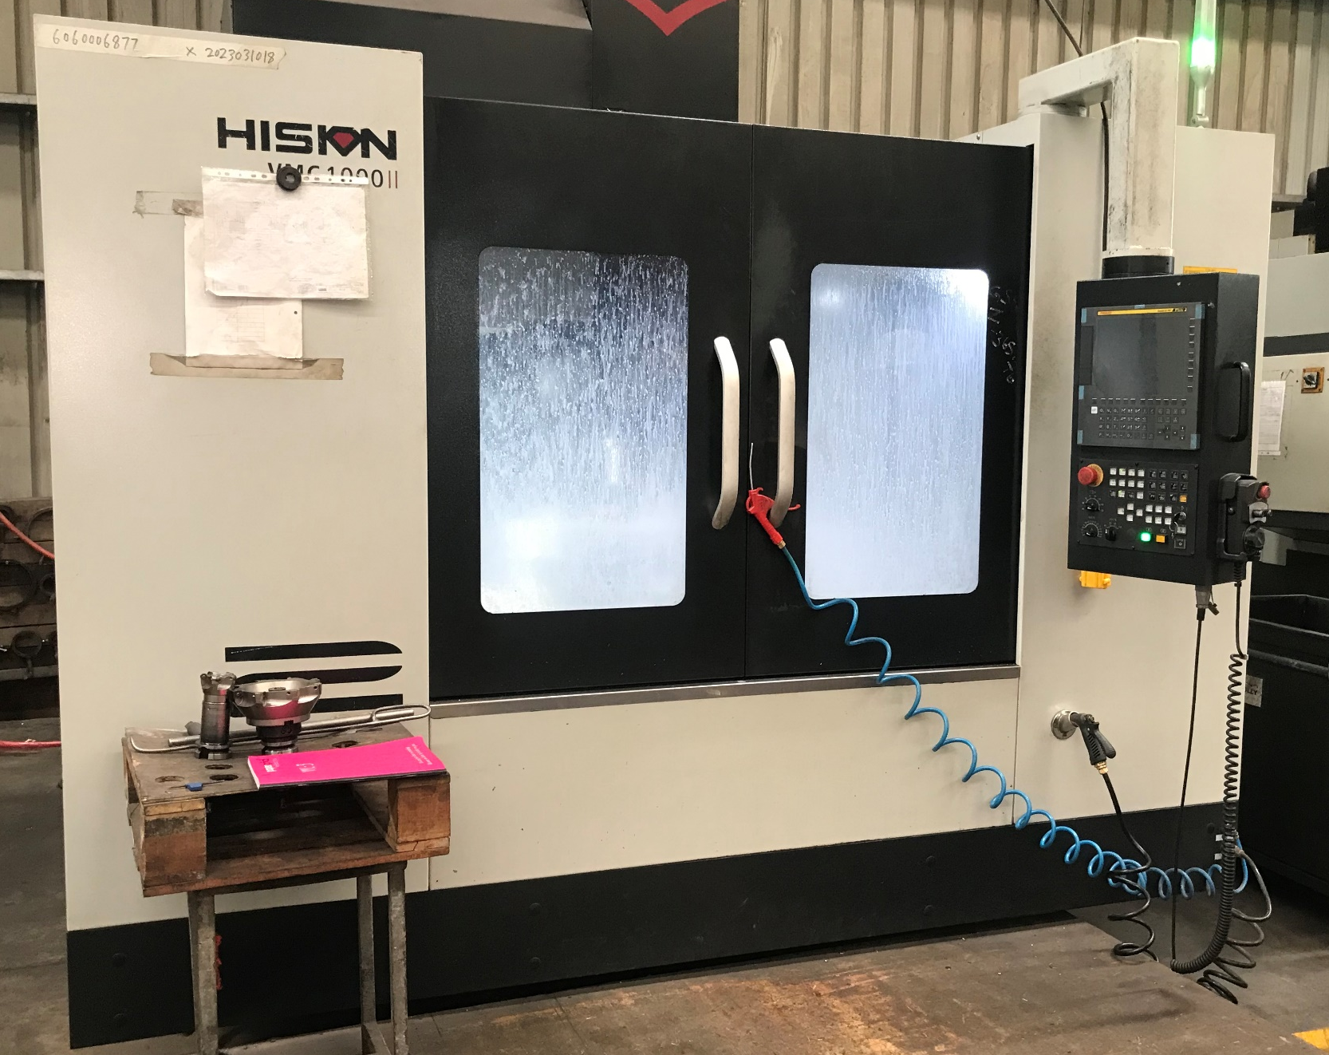
AIM Engineers India Pvt Ltd
Exit
Home
About Us
Facility
Portfolio
Clientele
HISION make VMC Model – 1000II
VMC 03
Size:
X-990mm Y-600mm Z-600mm,
Table – 1100 mm X 600 mm With ATC and CTS

Slide 15
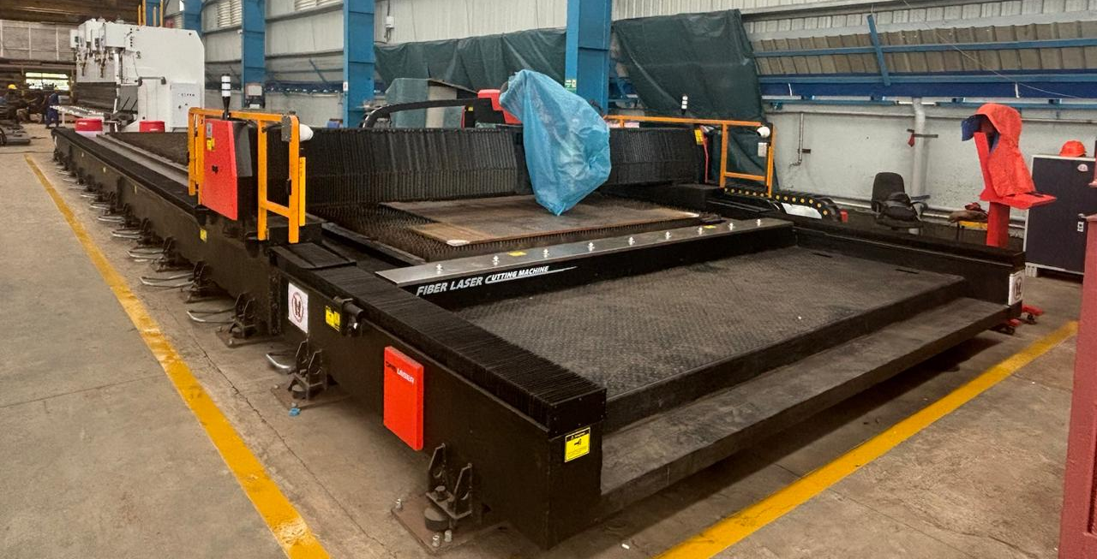
AIM Engineers India Pvt Ltd
Exit
Home
About Us
Facility
Portfolio
Clientele
- 20kW Laser cutting machine with bevel cutting head
Cutting Ability: CS – upto 50mm
SS – upto 40mm
Processing Size: 3mtrs x 14mtrs

Slide 16
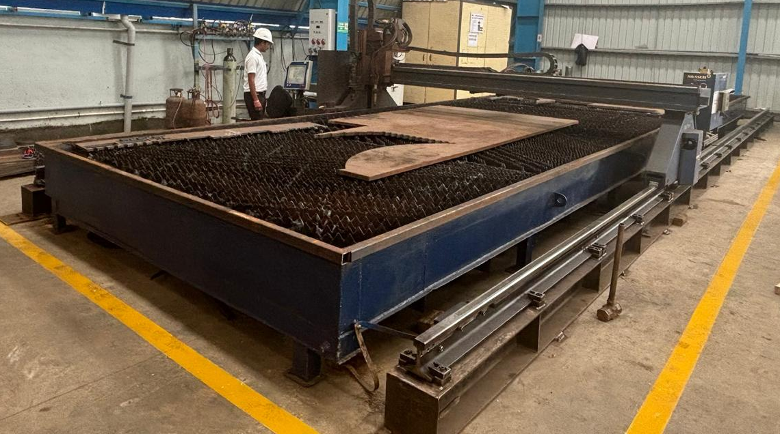
AIM Engineers India Pvt Ltd
Exit
Home
About Us
Facility
Portfolio
Clientele
Plasma Cutting Machine
Processing Size: 3m X 12.5m
SS – 50mm Thk,
CS – 250mm Thk

Slide 17
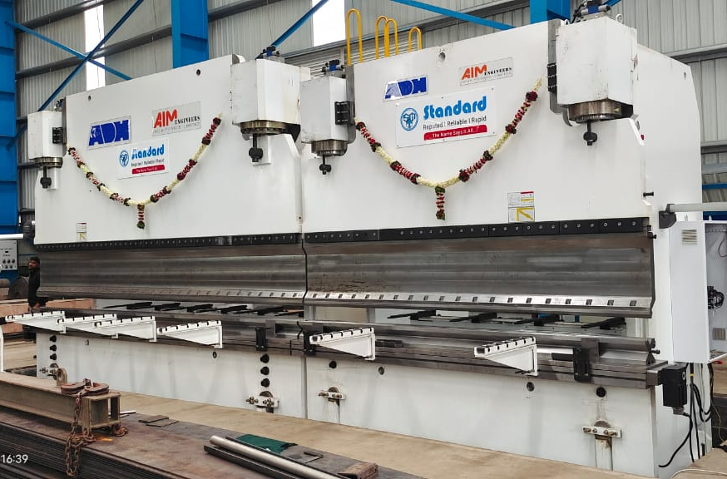
AIM Engineers India Pvt Ltd
Exit
Home
About Us
Facility
Portfolio
Clientele
- CNC Tandem Press Brake:
Capacity: 1300T x 10200 mm
Tooling:
1) Semi Goose Neck
2) Multi V Die (10.2mtrsx200mmx200mm)
3) Extra Adjustable Die: 20mm – 240mm
4) Insert R3, R45 (10.2mtrx45mmx45mm)

Slide 18
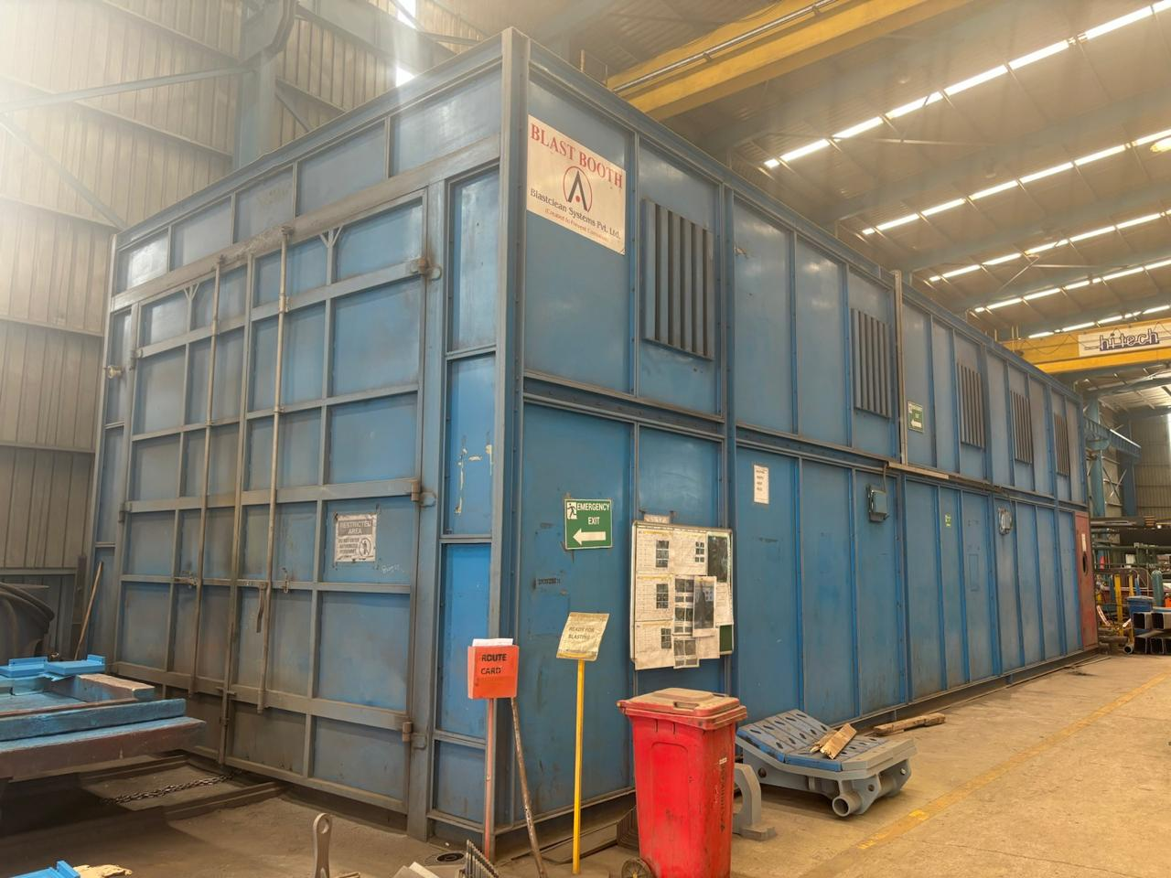
AIM Engineers India Pvt Ltd
Exit
Home
About Us
Facility
Portfolio
Clientele
Blasting Booth
Booth Size: 4m x 4m x 15m
Processing Size: 3.5m x 3.5m x 13.5m

Slide 19
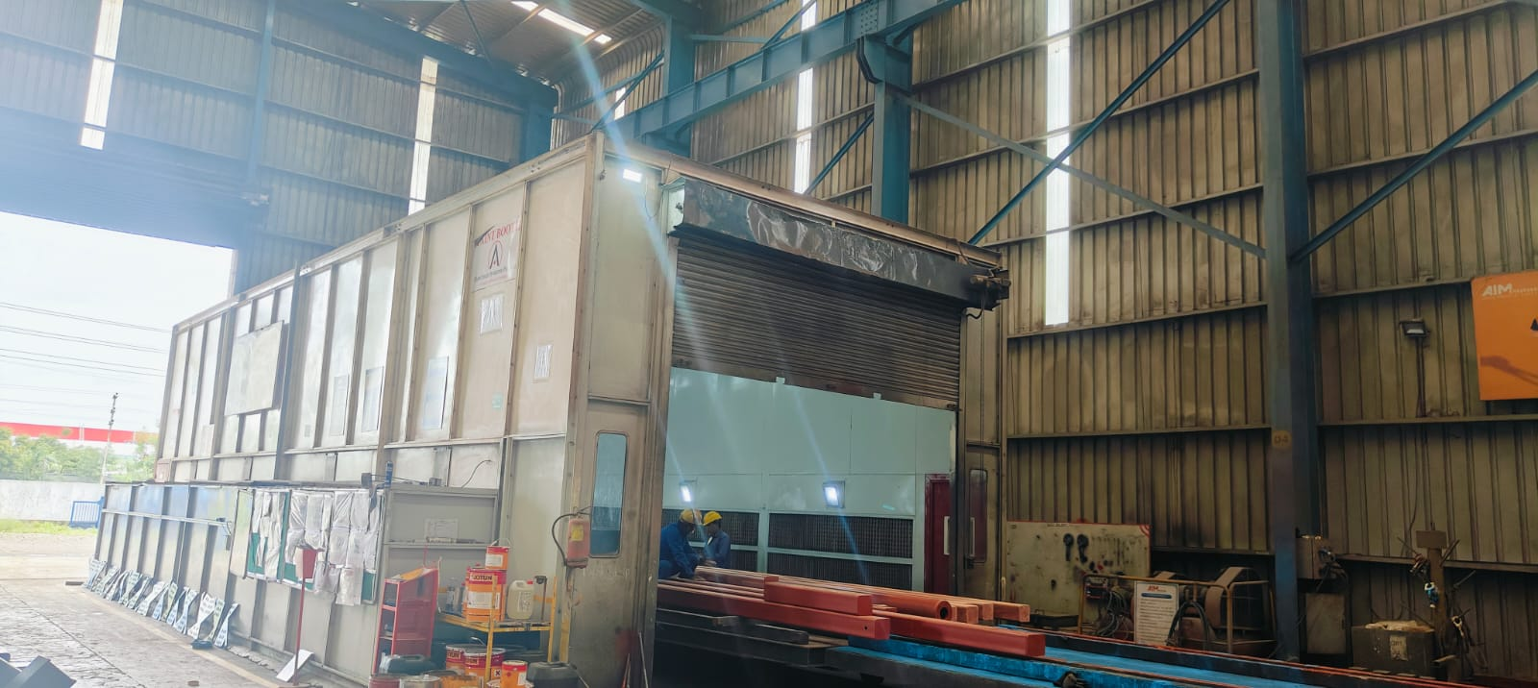
AIM Engineers India Pvt Ltd
Exit
Home
About Us
Facility
Portfolio
Clientele
Painting Booth
Booth Size: 4m x 4m x 15m
Processing Size: 3.5m x 3.5m x 13.5m

Slide 20
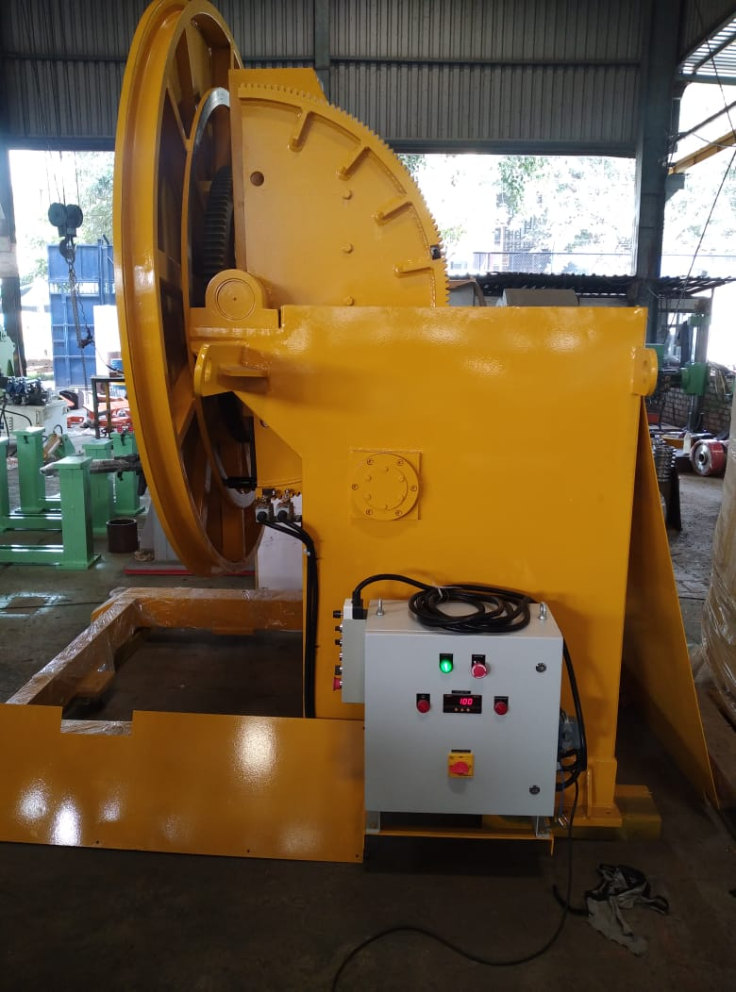
AIM Engineers India Pvt Ltd
Exit
Home
About Us
Facility
Portfolio
Clientele
1) Motorized Welding Positioner:
Dia – 2.5 mtrs
Load – 3 Ton
Rotation – 0 to 90 deg & 360 deg

Slide 21
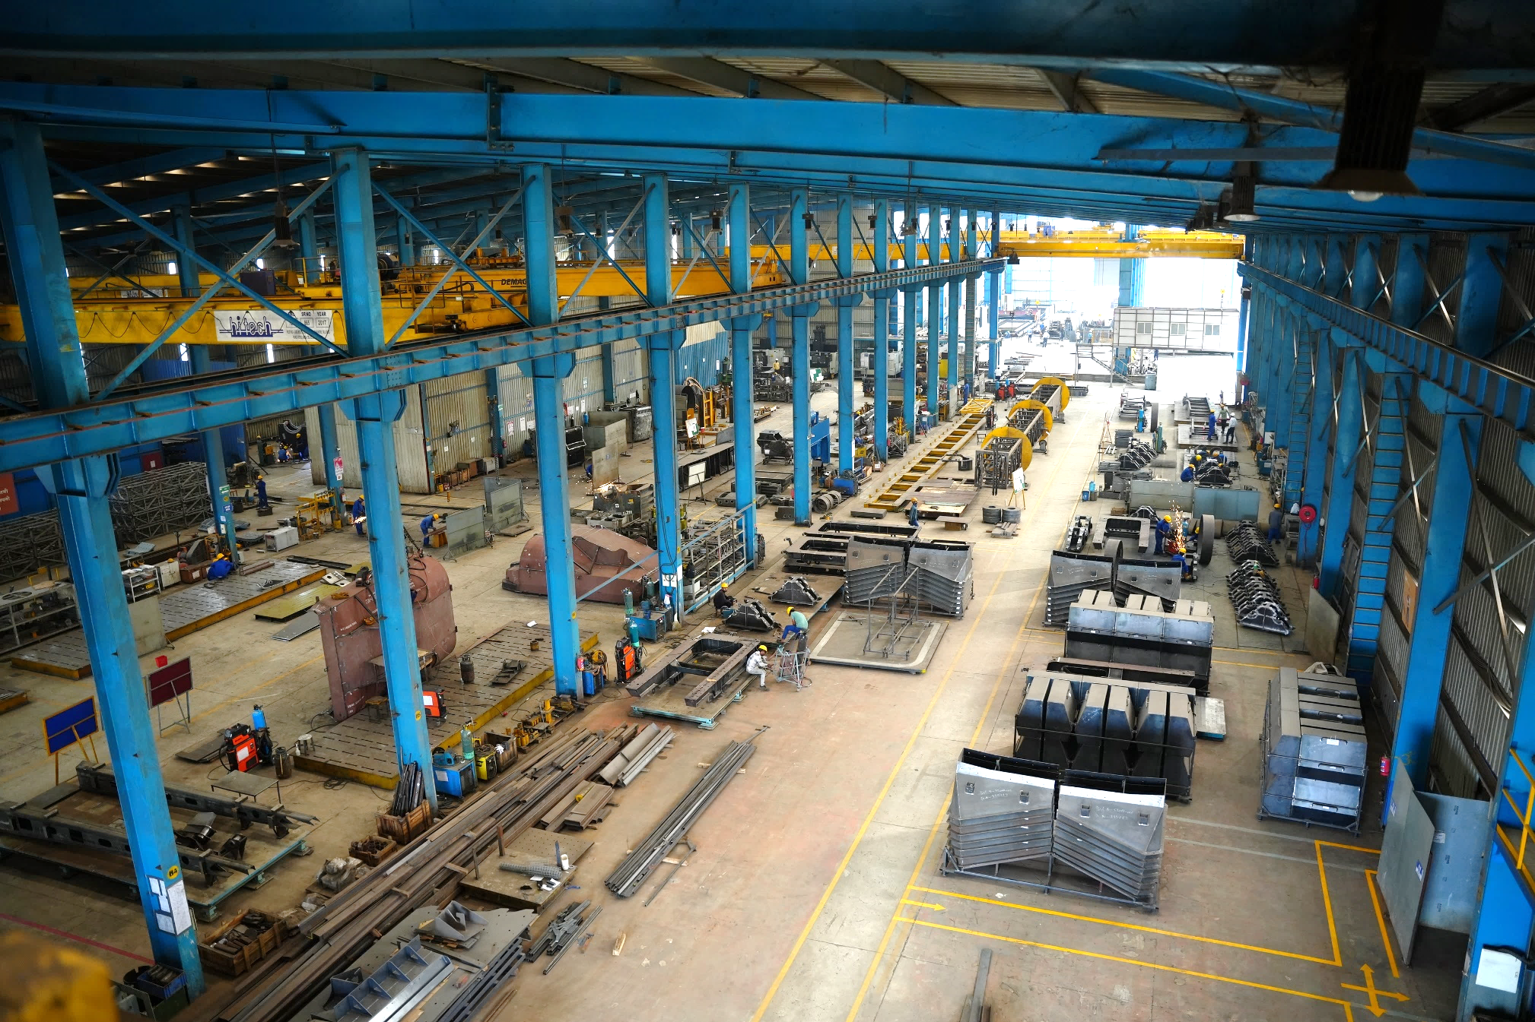
AIM Engineers India Pvt Ltd
Exit
Home
About Us
Facility
Portfolio
Clientele

Slide 22
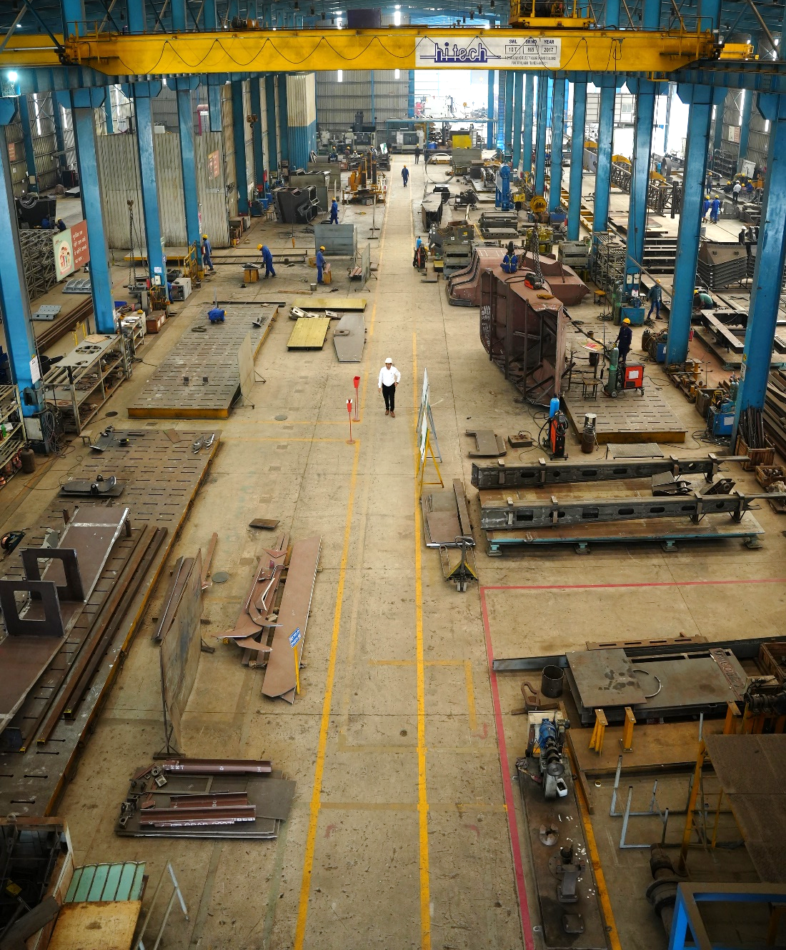
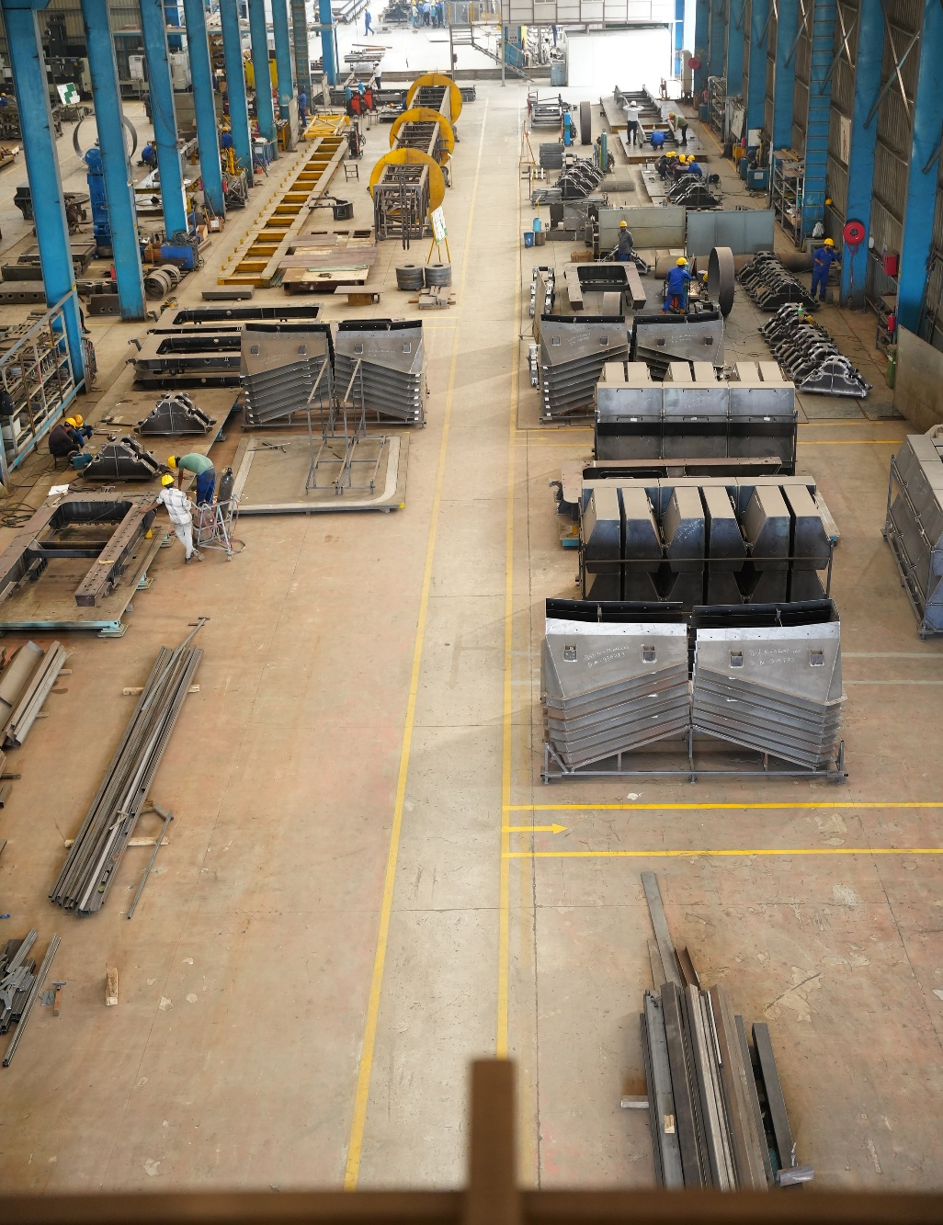
AIM Engineers India Pvt Ltd
Exit
Home
About Us
Facility
Portfolio
Clientele

Slide 23
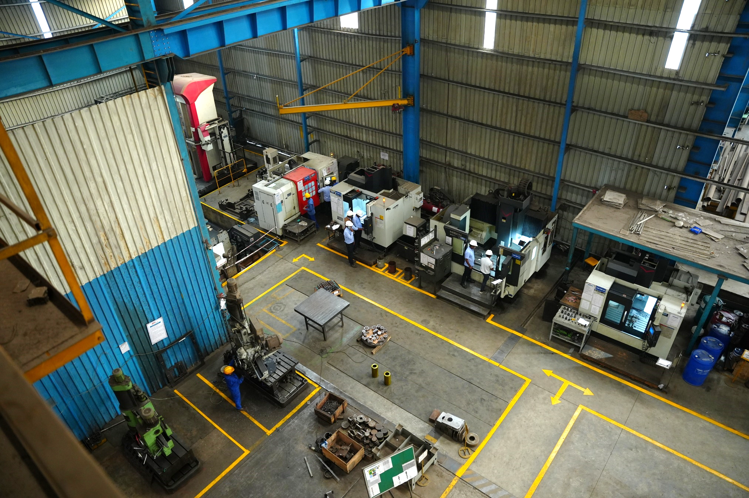
AIM Engineers India Pvt Ltd
Exit
Home
About Us
Facility
Portfolio
Clientele

Slide 24
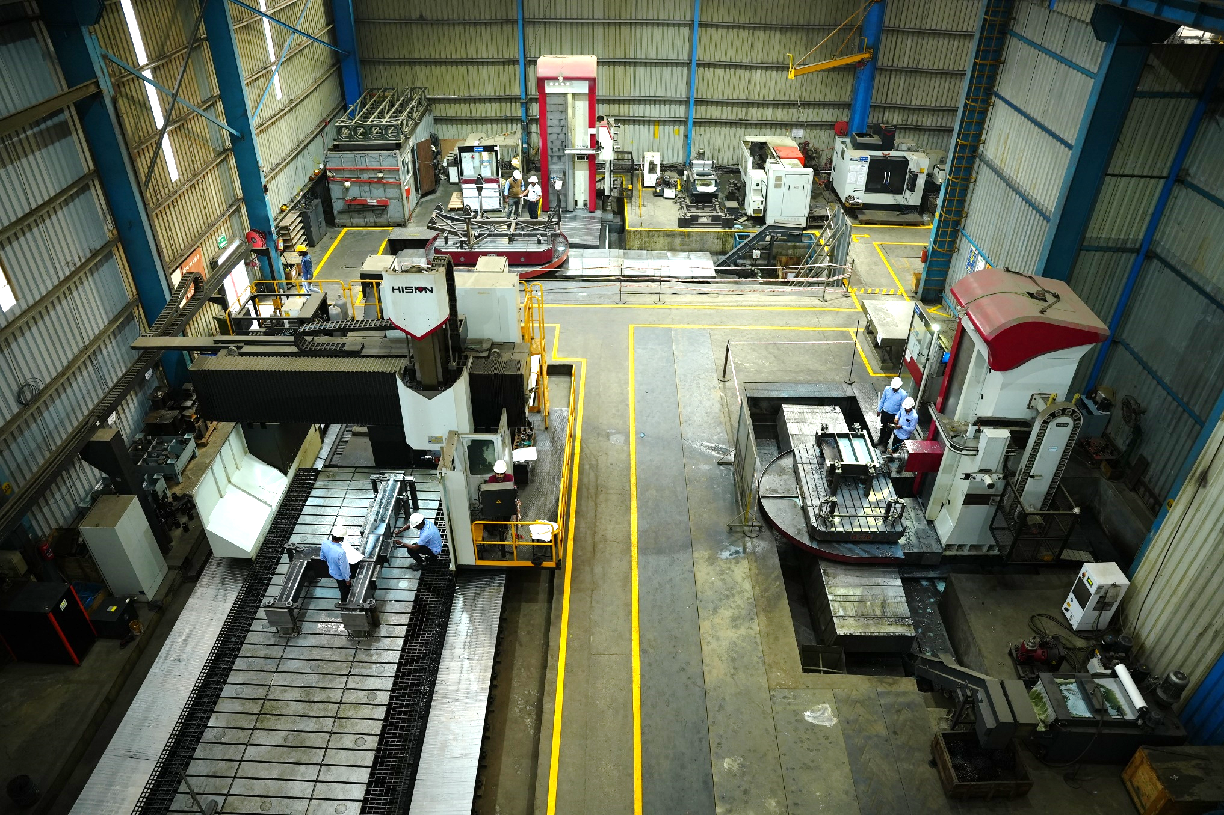
AIM Engineers India Pvt Ltd
Exit
Home
About Us
Facility
Portfolio
Clientele

Slide 25
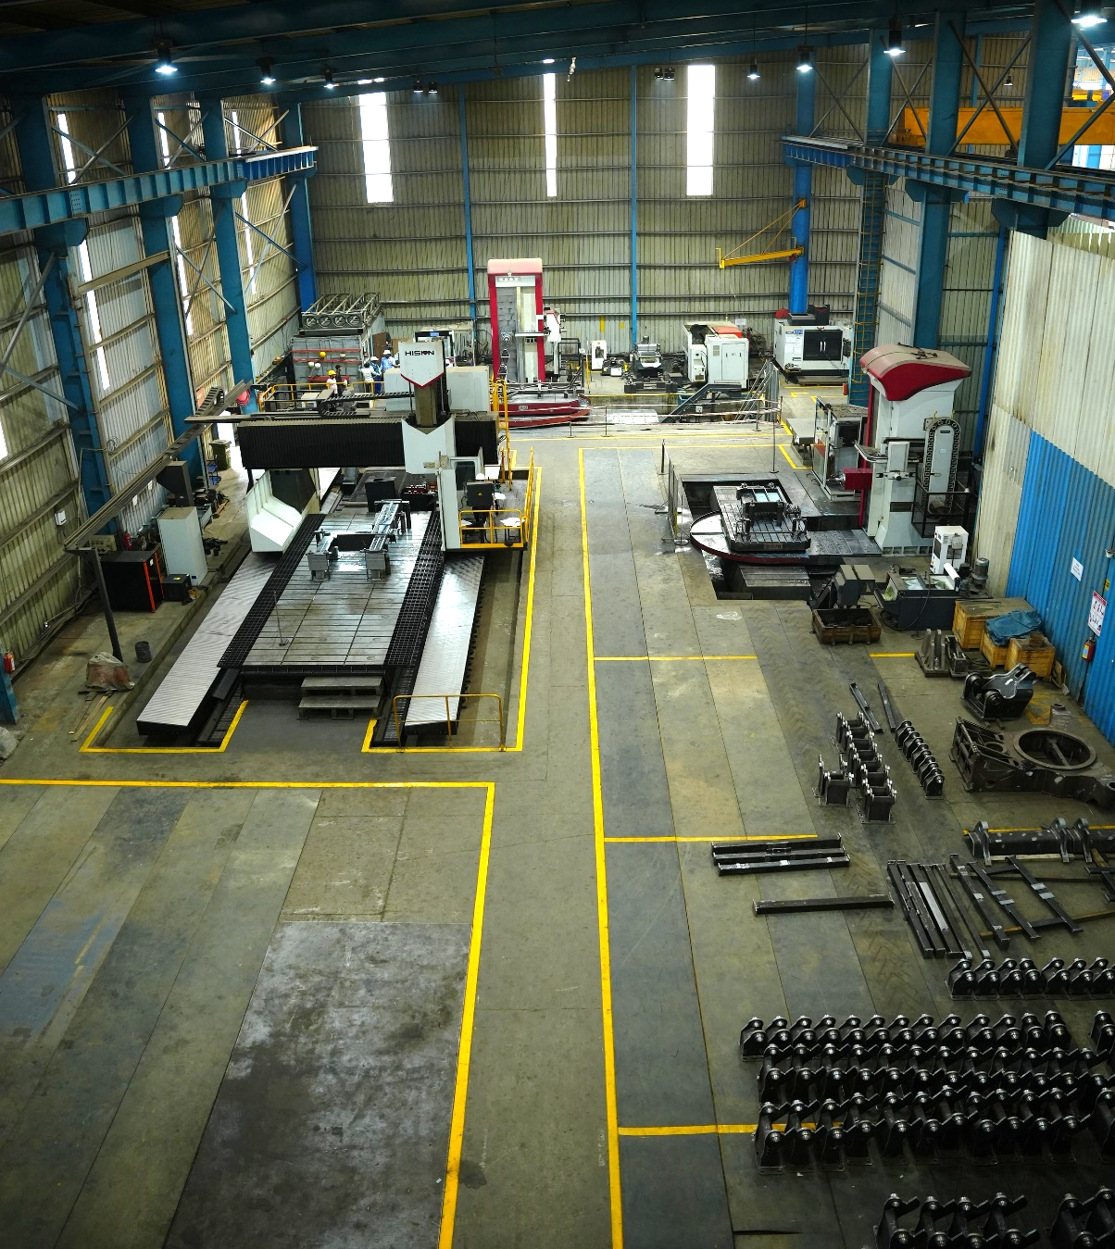
AIM Engineers India Pvt Ltd
Exit
Home
About Us
Facility
Portfolio
Clientele

Slide 26
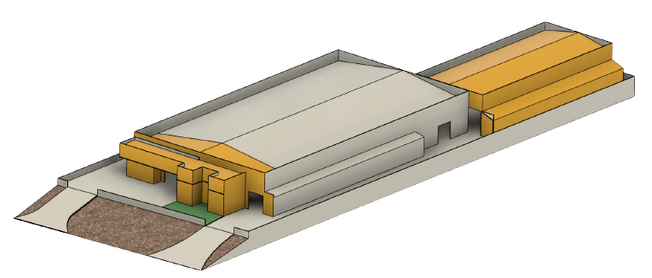
AIM Engineers India Pvt Ltd
Home
About Us
Facility
Portfolio
Clientele
3000 Sq Mtrs
4830 Sq Mtrs
720 Sq Mtrs
1000 Sq Mtrs
Yellow marked area is the Expansion Work
Out of Expansion work of 4720 Sq Mtrs, we have completed 3000 sq mtrs in Jan 2024.

Slide 27
AIM Engineers India Pvt Ltd
Exit
Home
About Us
Facility
Portfolio
Clientele
Quality Management System: ISO 9001:2015

Slide 28
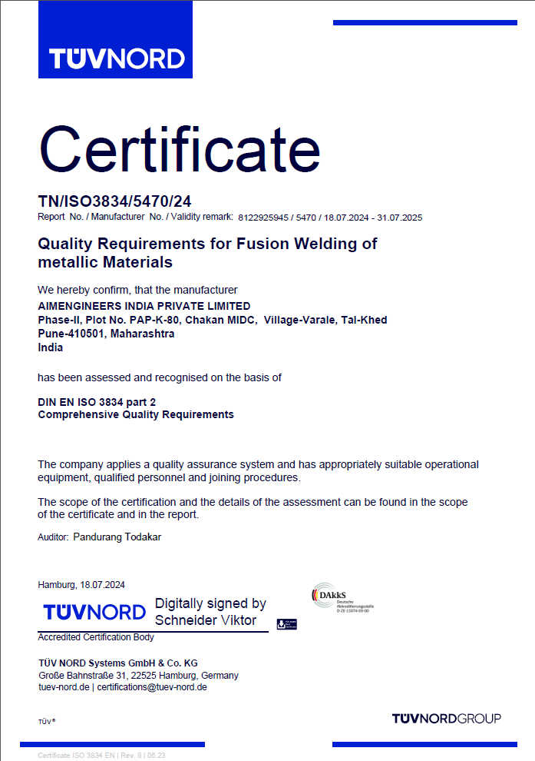
AIM Engineers India Pvt Ltd
Exit
Home
About Us
Facility
Portfolio
Clientele
Quality certificate for Fusion welding: IS3834-2

Slide 29
AIM Engineers India Pvt Ltd
Exit
Home
About Us
Facility
Portfolio
Clientele
Quality Management System: ISO 9001:2015
- Division I – Mining & Construction
Product Range – Crusher Frame, Rotors, Conveyors, Chutes, Hopper, Platform
- Division II – Projects
Chemical Plant
Thermal Plant,
Sugar Factory
Refinery
Pharma, Dairy, Breweries
Petro Chemical
Storage Tanks
Pressure Vessels
Heat exchangers
Reactors
Defense
Structure for MBRL, Flat Bed, Container Lifting Lifting
- Division III – Refurbishment for Mining & Construction Equipments
Inspection Agencies:
TUV, BV, AKPG, IQS, QUEST, LLOYDS, SAB - KCPC

Slide 30
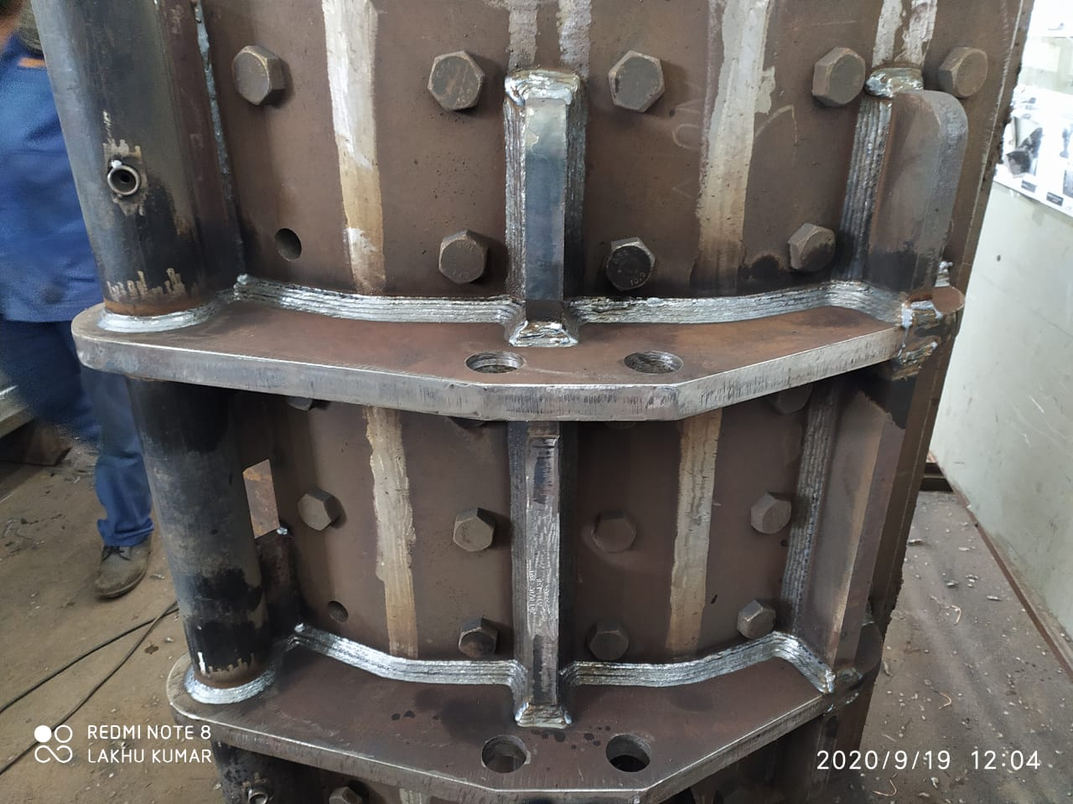
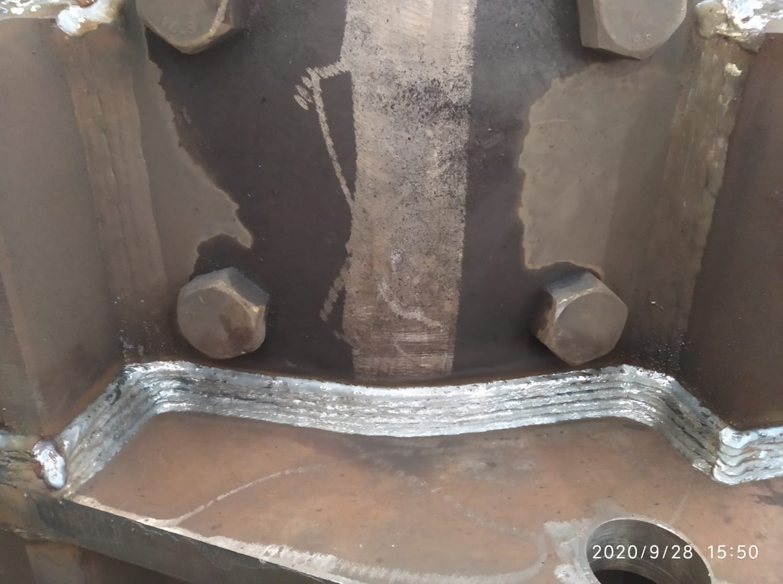
AIM Engineers India Pvt Ltd
Exit
Home
About Us
Facility
Portfolio
Clientele
Sample of our welding quality

Slide 31
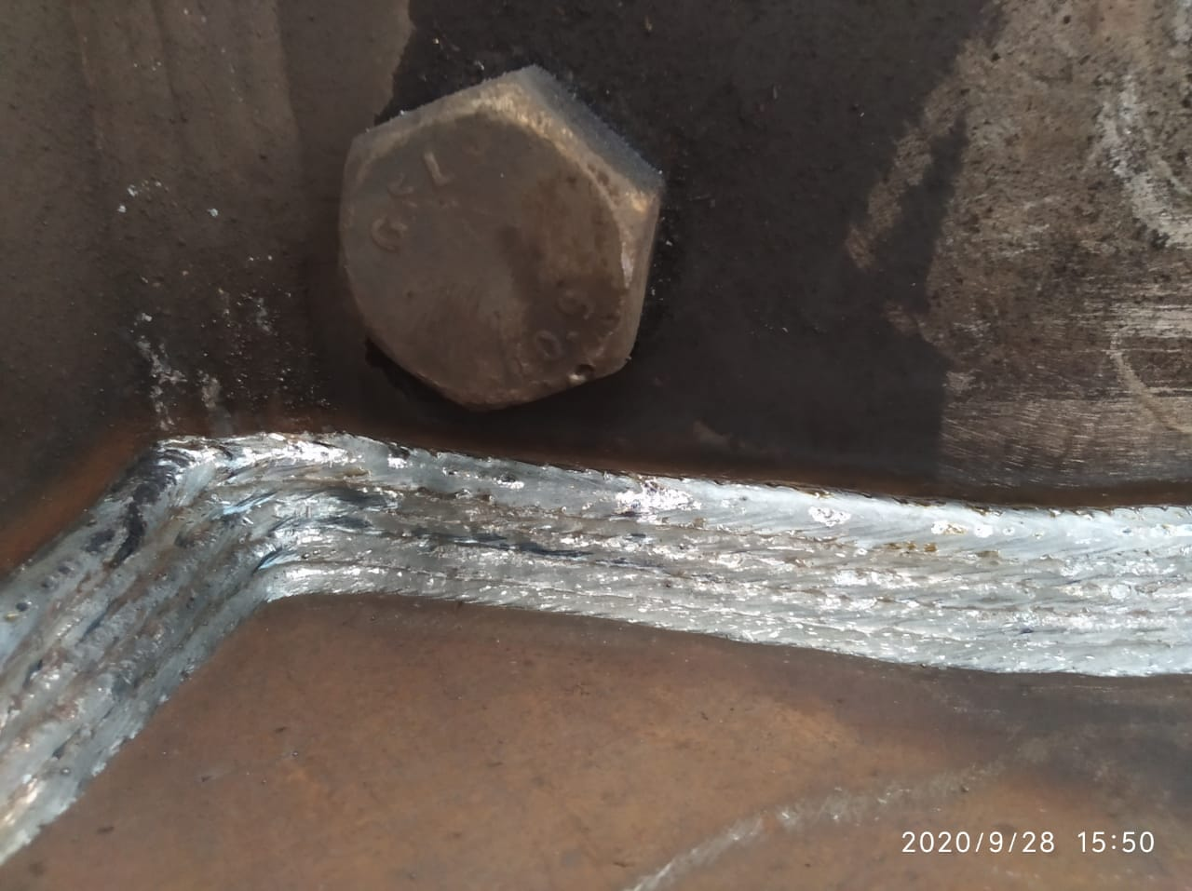
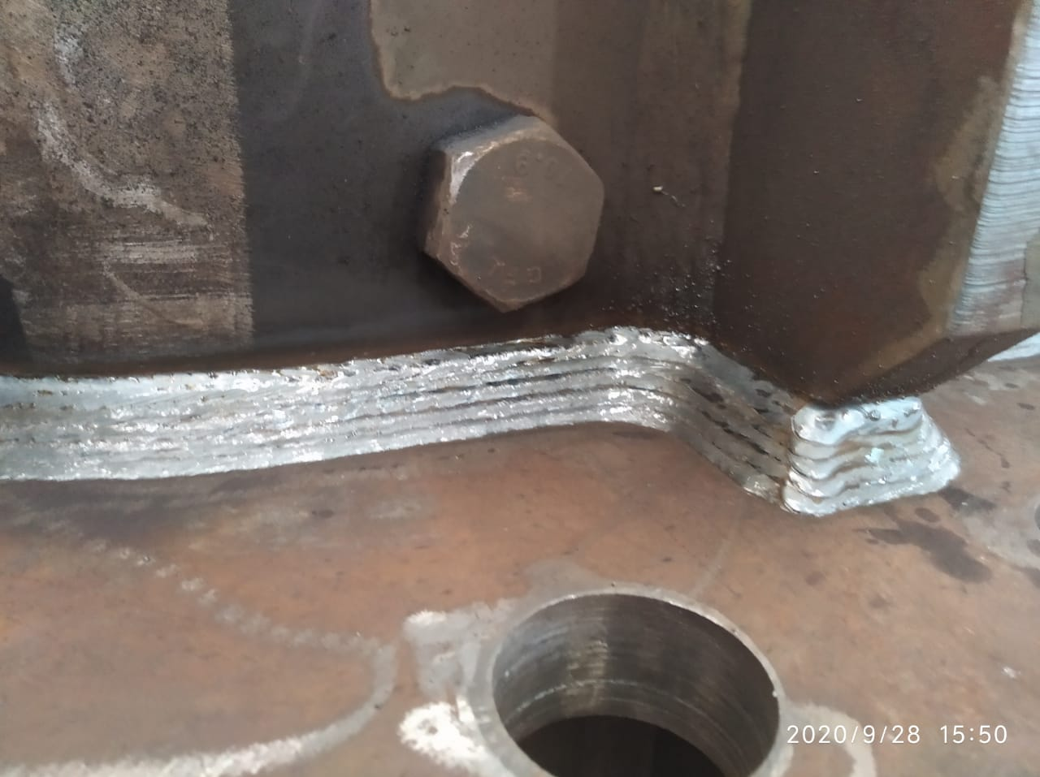
AIM Engineers India Pvt Ltd
Exit
Home
About Us
Facility
Portfolio
Clientele
In our quest to become one of the finest engineering firms, we plan to enhance our welding quality. And for the same we are in discussion with few robotic arm manufactures for developing customized solutions for AEIPL.

Slide 32

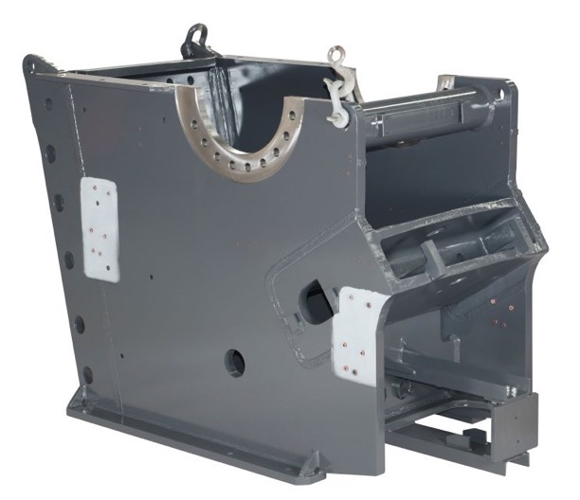
AIM Engineers India Pvt Ltd
Back
Exit
Home
About Us
Facility
Portfolio
Clientele
Customer – Sandvik Asia Ltd
Product - Jaw Crusher Frame CJ411, CJ409, CJ201
Plate Thickness – 63mm, 50mm, 50mm
Weight – 7.8T, 4.8T, 4.8T
Production per Month – 12 Nos
Application/Use – Stone Crushing

Slide 33
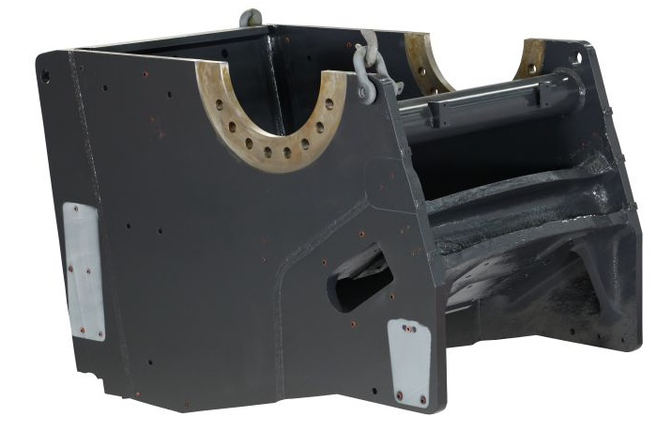
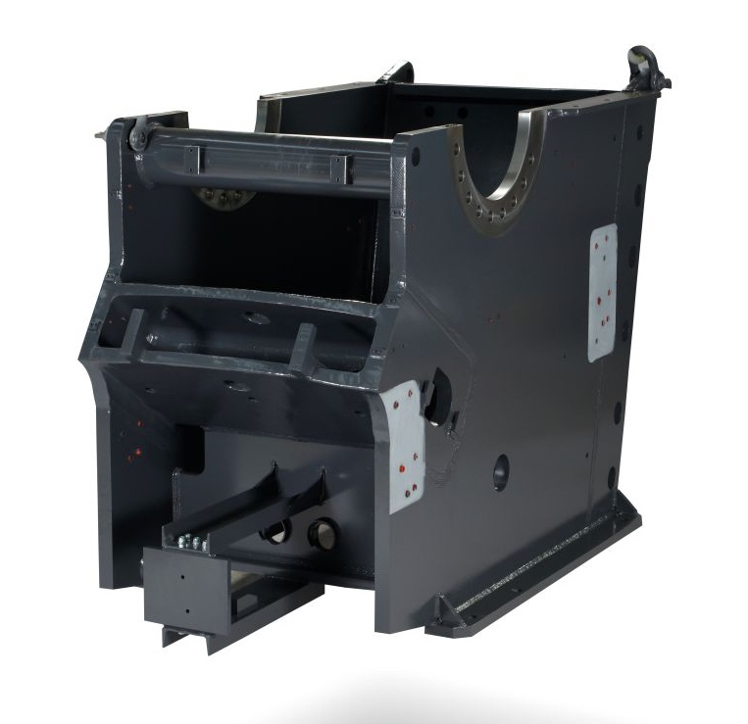
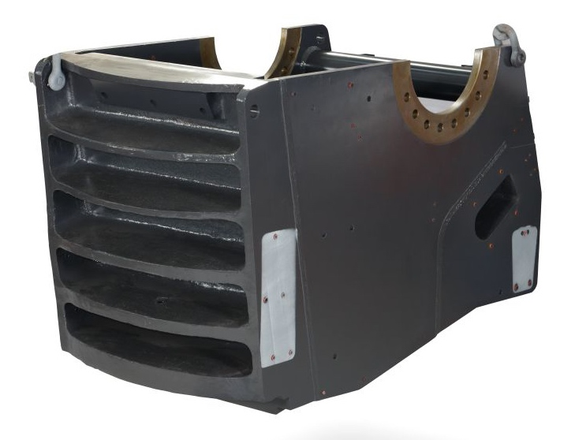
AIM Engineers India Pvt Ltd
Back
Exit
Home
About Us
Facility
Portfolio
Clientele

Slide 34
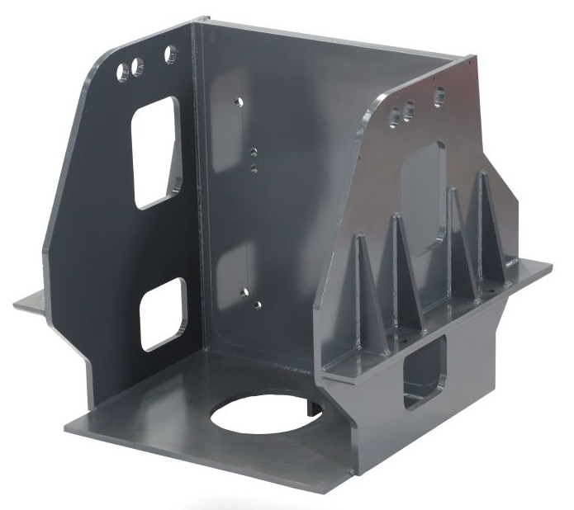
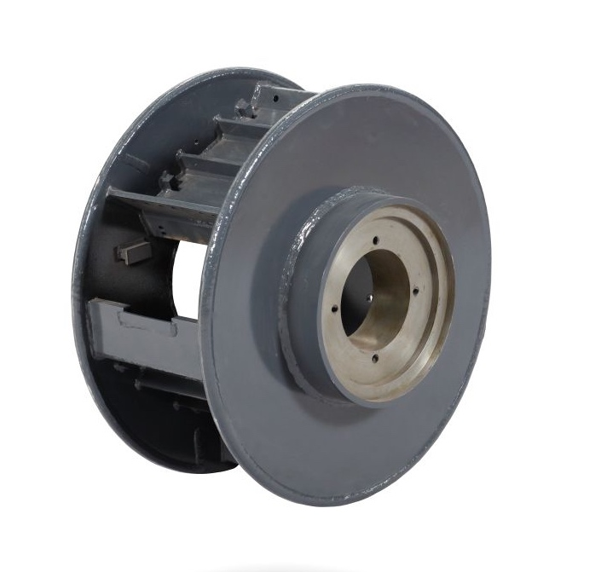
AIM Engineers India Pvt Ltd
Back
Exit
Home
About Us
Facility
Portfolio
Clientele

Slide 35
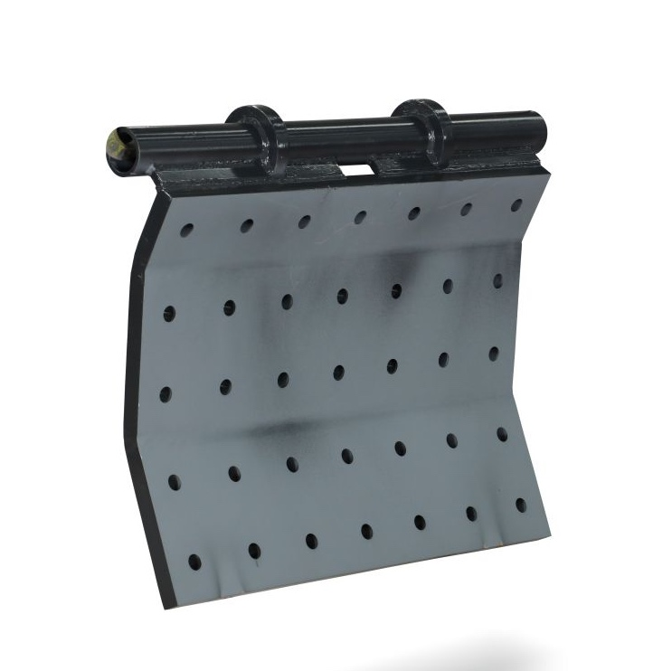
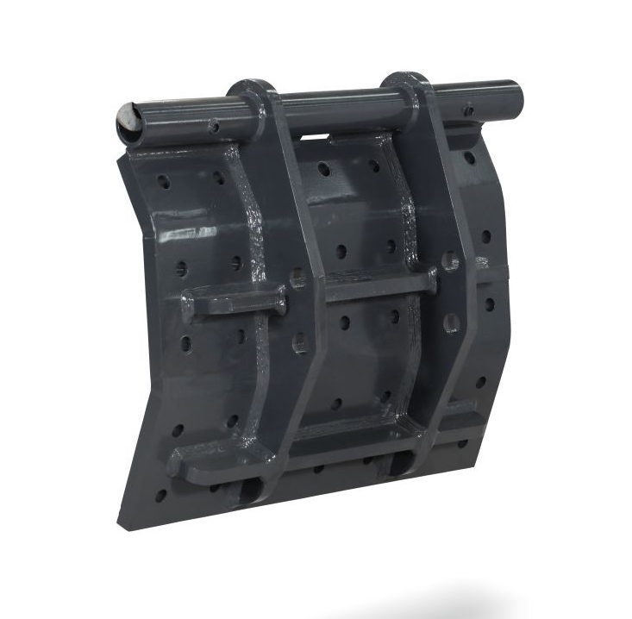
AIM Engineers India Pvt Ltd
Back
Exit
Home
About Us
Facility
Portfolio
Clientele

Slide 36
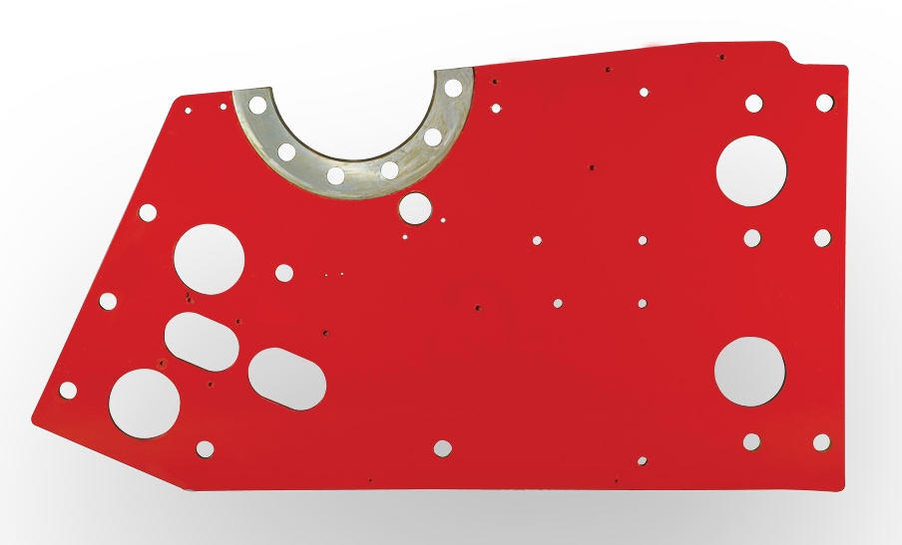
AIM Engineers India Pvt Ltd
Back
Exit
Home
About Us
Facility
Portfolio
Clientele

Slide 37
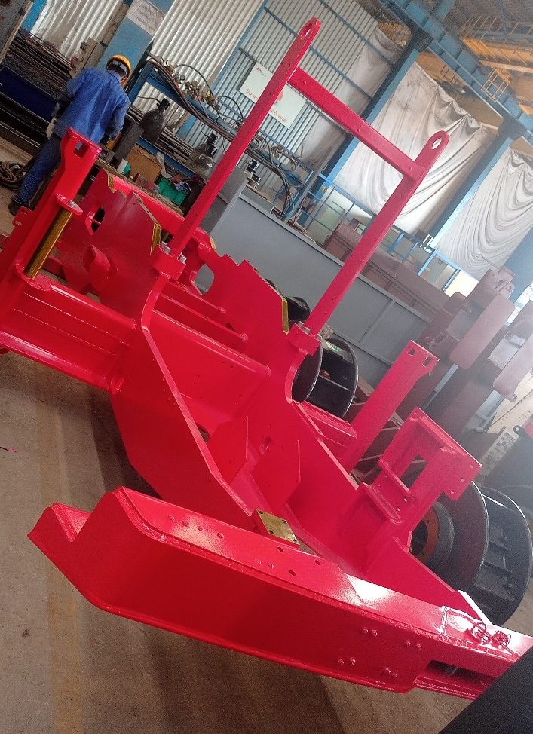
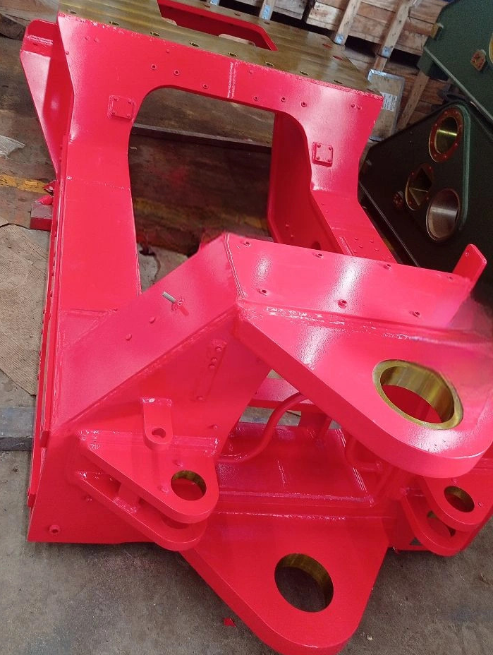
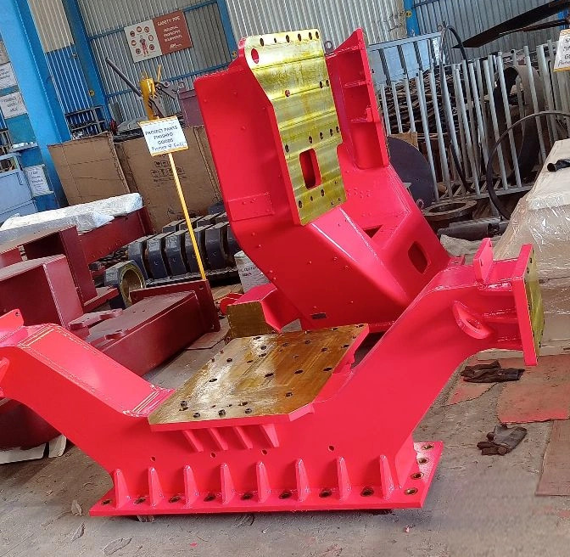
AIM Engineers India Pvt Ltd
Back
Exit
Home
About Us
Facility
Portfolio
Clientele

Slide 38
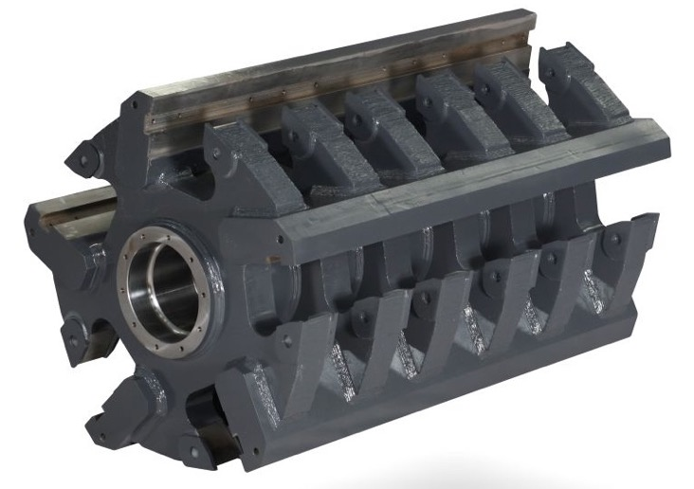
AIM Engineers India Pvt Ltd
Back
Exit
Home
About Us
Facility
Portfolio
Clientele
Customer – Sandvik Asia Ltd
Product – HSI Rotor
Plate Thickness – 150mm, 120mm
Job Weight – 1.5T, 3T, 7T
Production per month – 8 Nos
Application/Use – Stone Crushing

Slide 39
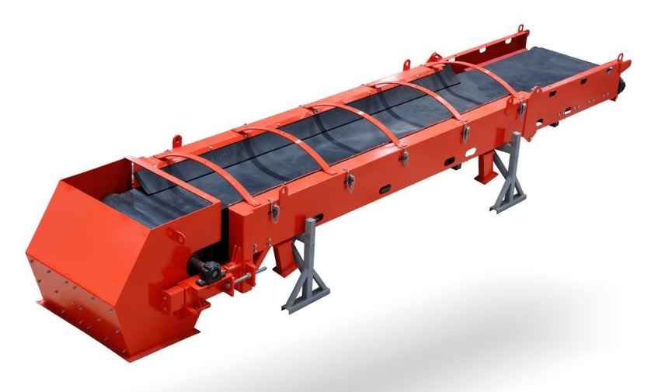
AIM Engineers India Pvt Ltd
Back
Exit
Home
About Us
Facility
Portfolio
Clientele
Customer – Sandvik Asia Ltd
Product – Conveyor CJ310, CJ300,
UD211
Length – 6.5m, 8m, 12m
Job Weight – 4T, 6T, 8T
Per Month – 6 Nos
Application/Use - Stone Crushing

Slide 40
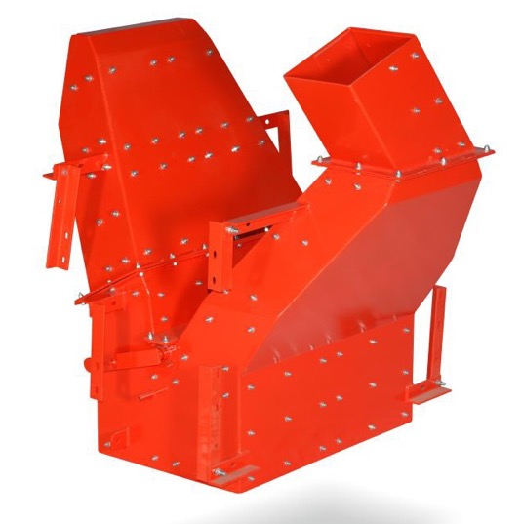
AIM Engineers India Pvt Ltd
Back
Exit
Home
About Us
Facility
Portfolio
Clientele
Customer – Sandvik Asia Ltd
Product - Chutes
Plate Thickness – 6mm
Job Weight – 0.4T to 1T
Per Month – 6 Nos
Application/Use - Stone Crushing

Slide 41

AIM Engineers India Pvt Ltd
Back
Exit
Home
About Us
Facility
Portfolio
Clientele
Customer – Sandvik Asia Ltd
Product - Hopper
Plate Thickness – 10 to 16 mm
Job Weight – 5T - 10T
Per Month – 6 Nos
Application/Use - Stone Crushing

Slide 42

AIM Engineers India Pvt Ltd
Back
Exit
Home
About Us
Facility
Portfolio
Clientele
Customer – Sandvik Asia Ltd
Product – Platforms
Job Weight – Max 0.5 T
Per Month – 6 Nos
Application/Use - Stone Crushing

Slide 43

AIM Engineers India Pvt Ltd
Back
Exit
Home
About Us
Facility
Portfolio
Clientele

Slide 44

AIM Engineers India Pvt Ltd
Back
Exit
Home
About Us
Facility
Portfolio
Clientele

Slide 45

AIM Engineers India Pvt Ltd
Back
Exit
Home
About Us
Facility
Portfolio
Clientele
Product Name: Upper and lower mast , Base frame assembly
Client: Sandvik Asia Pvt Ltd.
Weight: 3 tons
Application: Mining exploration

Slide 46

AIM Engineers India Pvt Ltd
Back
Exit
Home
About Us
Facility
Portfolio
Clientele
Product Name: Pit Viper
Client: Epiroc Mining India Ltd.
Weight: 10 tons, Length: 24 Mtrs
Application: Mining exploration

Slide 47

AIM Engineers India Pvt Ltd
Back
Exit
Home
About Us
Facility
Portfolio
Clientele
Product Name: Dump Box
Client: Epiroc Mining India Ltd.
Weight: 5.75 T
Application: Mining exploration

Slide 48

AIM Engineers India Pvt Ltd
Back
Exit
Home
About Us
Facility
Portfolio
Clientele
Product Name: Stator Housing
Client: Flender
Weight: 1.8 T
Application: Wind energy

Slide 49

AIM Engineers India Pvt Ltd
Exit
Home
About Us
Facility
Portfolio
Clientele
New Addition to Clientele: Precision fabrication and machined structure for Defence.
Underframe for Pinaka Multi Barrel rocket Launcher

Slide 50

AIM Engineers India Pvt Ltd
Exit
Home
About Us
Facility
Portfolio
Clientele
Cradle for Pinaka Multi Barrel rocket Launcher

Slide 51

AIM Engineers India Pvt Ltd
Exit
Home
About Us
Facility
Portfolio
Clientele
Rotating Base Body for Pinaka Multi Barrel Rocket Launcher

Slide 52

AIM Engineers India Pvt Ltd
Exit
Home
About Us
Facility
Portfolio
Clientele
Structures for Army

Slide 53

AIM Engineers India Pvt Ltd
Exit
Home
About Us
Facility
Portfolio
Clientele
Structures for Army

Slide 54


AIM Engineers India Pvt Ltd
Exit
Home
About Us
Facility
Portfolio
Clientele
Structures for Airforce

Slide 55

AIM Engineers India Pvt Ltd
Exit
Home
About Us
Facility
Portfolio
Clientele
Oil Separators for Atlas Copco

Slide 56

AIM Engineers India Pvt Ltd
Exit
Home
About Us
Facility
Portfolio
Clientele
Product Name: Calendria
Client: Alfa Laval – Saba Chemicals - Malaysia
Weight: 60 tons
Application: Chemicals

Slide 57

AIM Engineers India Pvt Ltd
Exit
Home
About Us
Facility
Portfolio
Clientele
Product Name: Heat Exchanger
Client: KCPC japan
Weight: 600 kg
Application: Pharma

Slide 58

AIM Engineers India Pvt Ltd
Exit
Home
About Us
Facility
Portfolio
Clientele
Product Name: Calendria
Client: Alfa Laval – Vedanta Aluminum
Weight: 120 tons
Application: Smelting Plant

Slide 59

AIM Engineers India Pvt Ltd
Exit
Home
About Us
Facility
Portfolio
Clientele
Medical Oxygen Plant

Slide 60

AIM Engineers India Pvt Ltd
Exit
Home
About Us
Facility
Portfolio
Clientele
VAT Pulper:

Slide 61

AIM Engineers India Pvt Ltd
Exit
Home
About Us
Facility
Portfolio
Clientele
Cladded Frame:

Slide 62









AIM Engineers India Pvt Ltd
Exit
Home
About Us
Facility
Portfolio
Clientele

Slide 63
AIM Engineers India Pvt Ltd
Exit
Home
About Us
Facility
Portfolio
Clientele
Thank You

